Slide 1
Measurement of Energy-dependent Inclusive Muon Neutrino Charged-Current Cross Section at MicroBooNE
Wenqiang Gu (BNL)
On behalf of MicroBooNE collaboration
Notes:
Good afternoon, everyone. Thanks for the introduction and I am very glad to be here to report our recent measurement of the energy-dependent inclusive muon neutrino charged-current cross section at MicroBooNE.

Slide 2
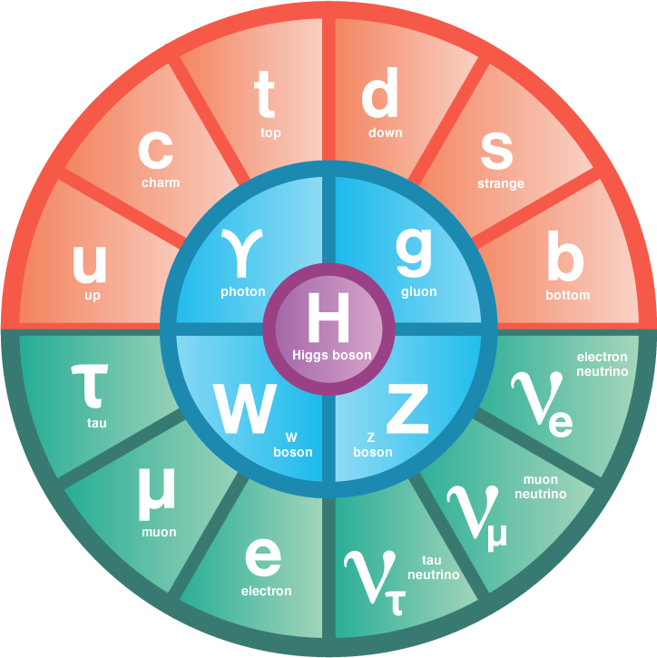
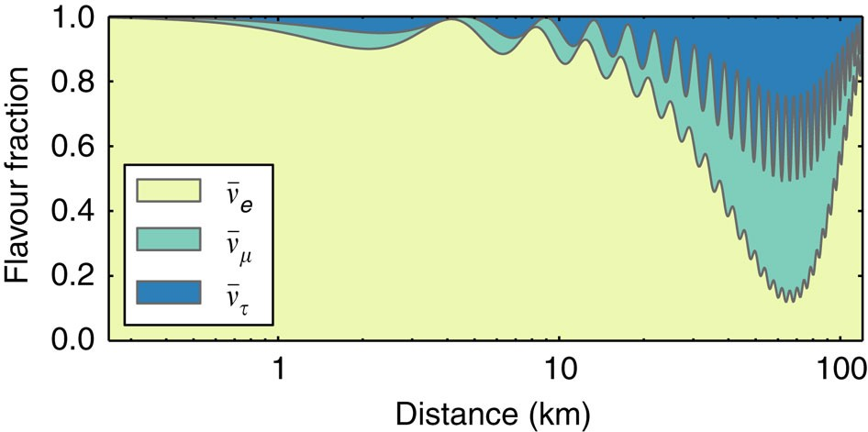
Neutrino Oscillation
Nature Comm. 6, 6935
Neutrino oscillation experiments have provided the first evidence for physics beyond the Standard Model of particle physics
Notes:
As fundamental particles in the standard model, neutrinos have given us a lot of surprises.
Neutrino flavor oscillation is the first evidence of physics beyond the standard model.

Slide 3
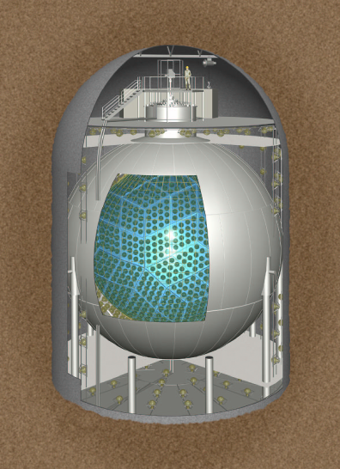
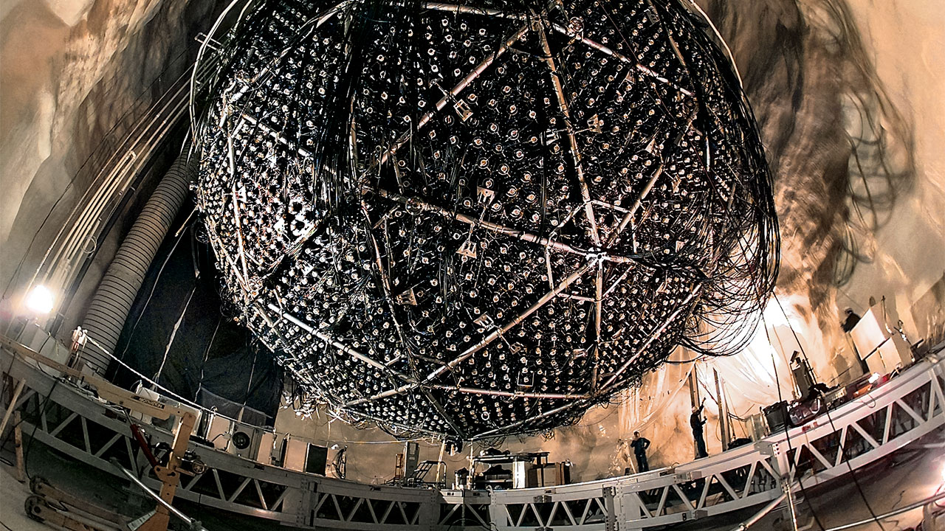
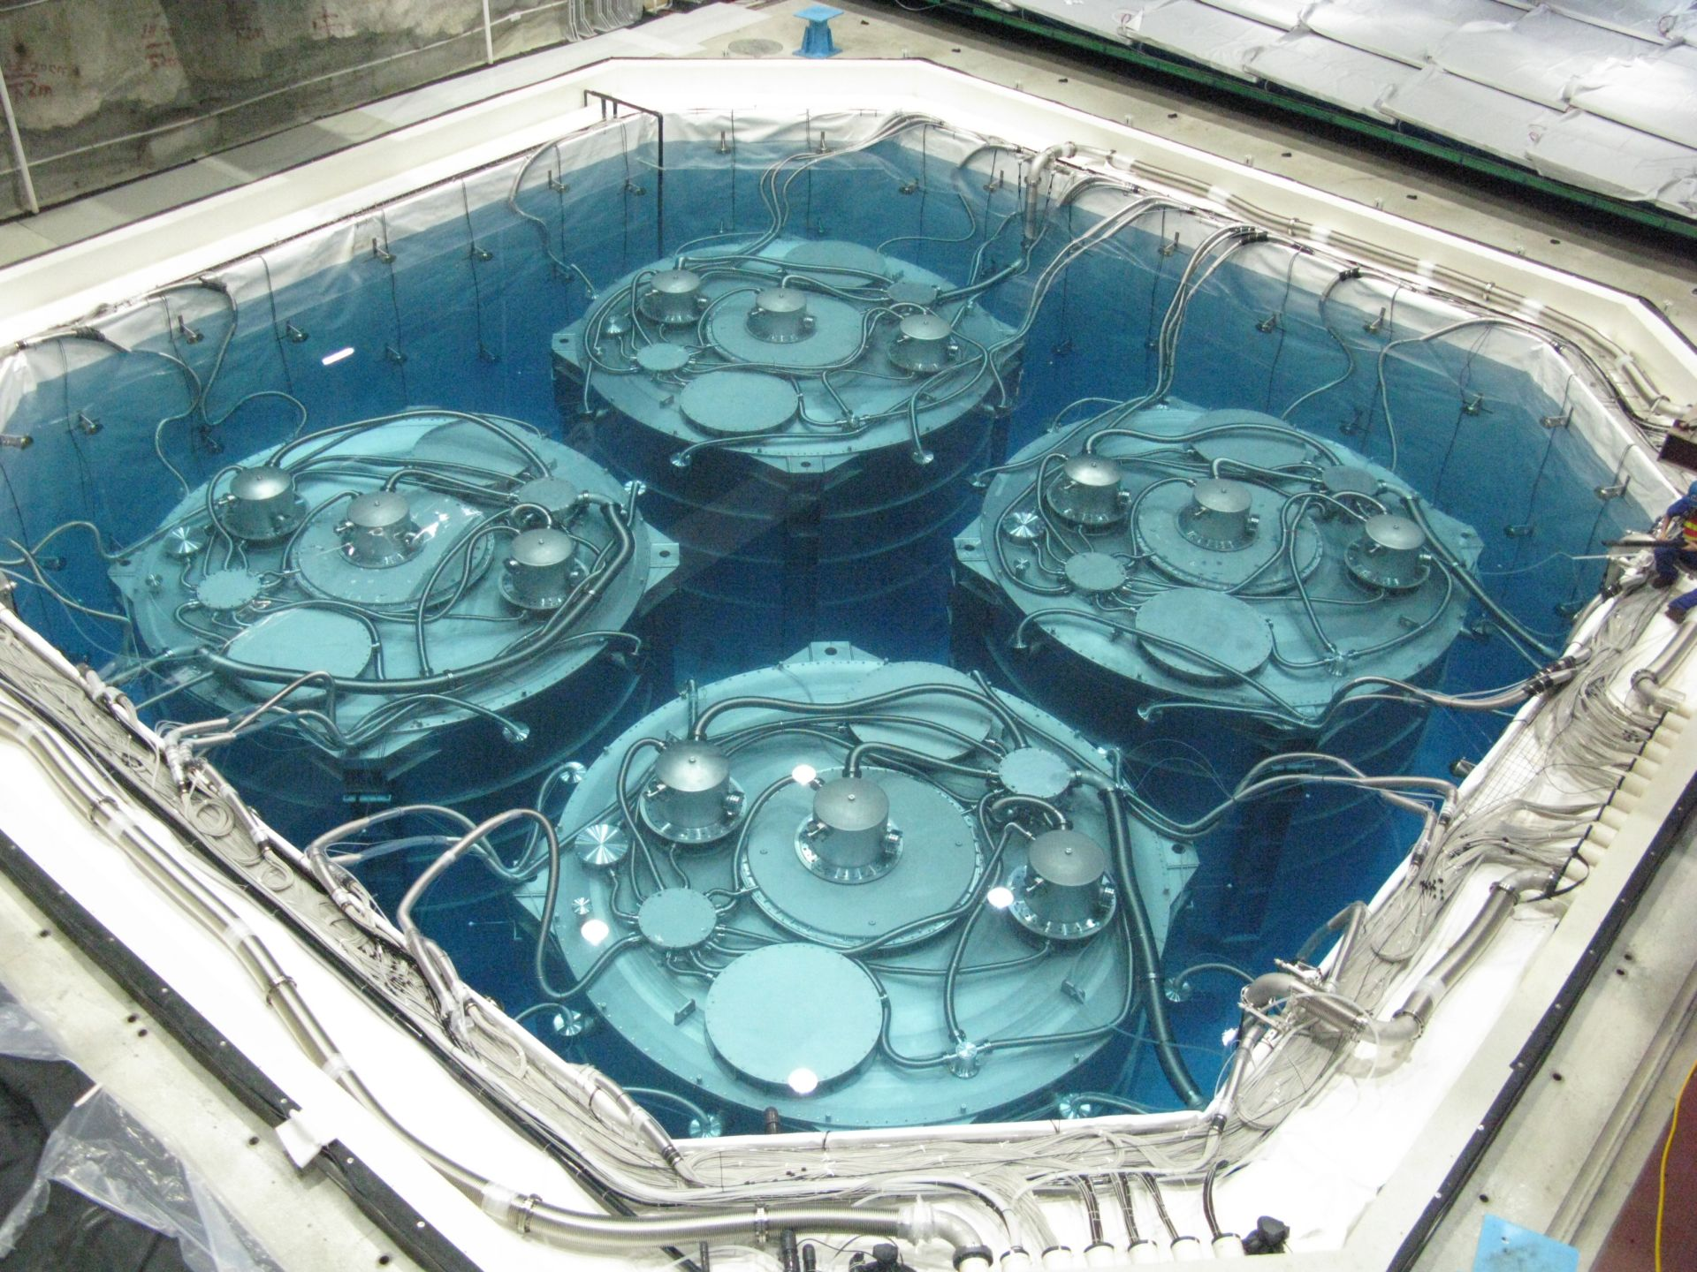
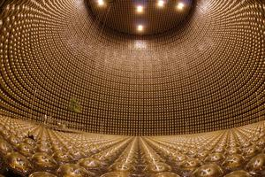
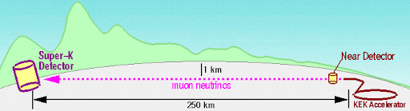
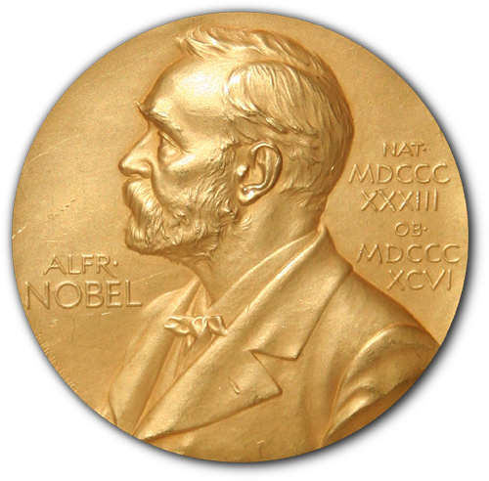
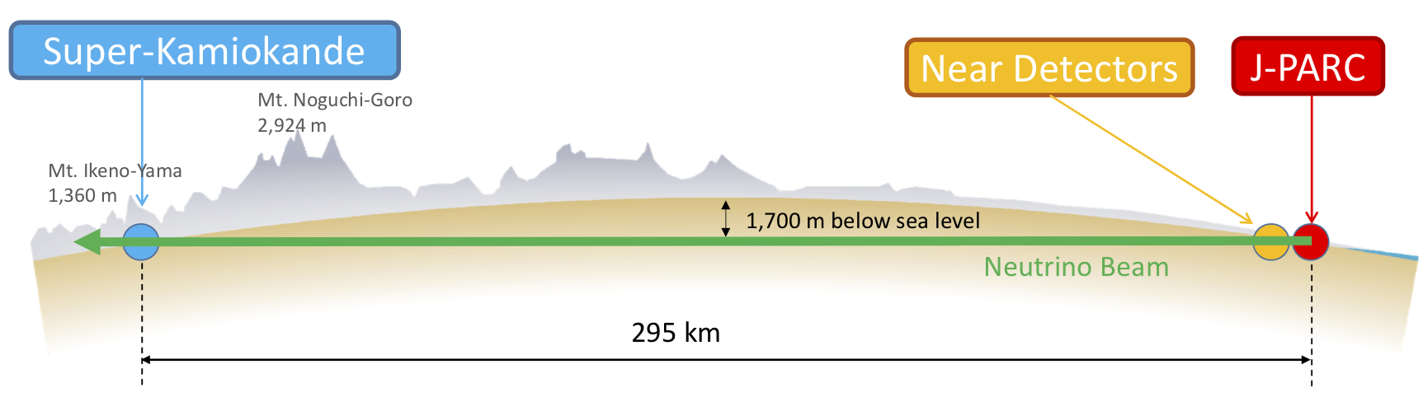
2016 Breakthrough Prize
KamLAND
Daya Bay
SNO
K2K
Super-K
T2K
2015 Nobel Prize
Takaaki Kajita & Arthur B. McDonald
Notes:
In 2016, for the first time, five experiments with close to1400 members were awarded the breakthrough prize of fundamental physics for their work in investigating neutrino oscillations.
Among them, the leader of the SNO experiment detecting solar neutrinos and Super-K experiment detecting atmospheric neutrinos were awarded the 2015 Nobel Prize.
The other experiments include KamLAND and Daya Bay experiments detecting man-made reactor neutrinos and the K2K/T2K experiments detecting accelerator neutrinos.
---
[The (BNL/Stony Brook neutrino group) has made leading contribution to the Super-K, K2K and T2K experiments.]

Slide 4
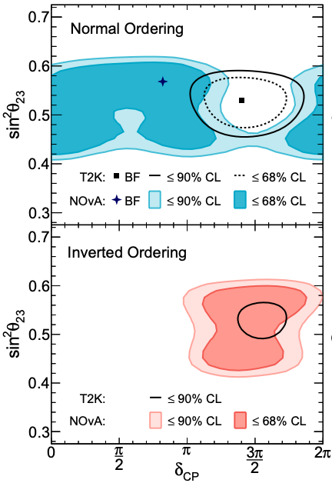
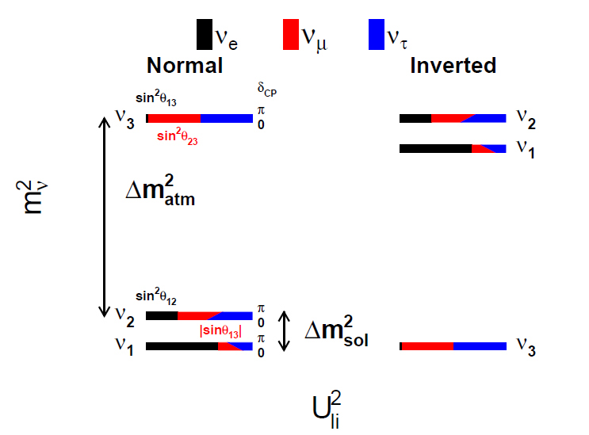
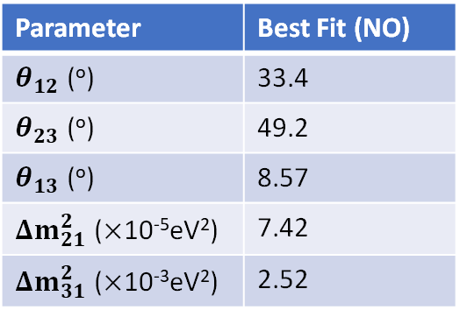
Current understanding of neutrino mass & mixing
JHEP 09 (2020) 178
Parameter | Best Fit (NO)
$θ_{12}$ (º) | 33.4
$θ_{23}$ (º) | 49.2
$θ_{13}$ (º) | 8.57
$Δm_{21}^{2}$ ($×$10⁻⁵eV²) | 7.42
$Δm_{31}^{2}$ ($×$10⁻³eV²) | 2.52
T2K: Nature 580, 339–344 (2020)
NOvA: arXiv:2108.08219
Is neutrino mass ordering “normal” or “inverted”?
Is there new CP violation?
Could it explain the matter anti-matter asymmetry in the universe?
Notes:
In the three-neutrino paradigm describing neutrino flavor oscillation, the non-zero neutrino mass and mixing can be described by three mixing angles, one CP phase and two mass-squared splittngs.
Given all the experimental efforts, many of the parameters have been measured to high precision. Nevertheless, there are still some remaining questions. For example, we do not yet know whether the third neutrino mass eigen state is heavier or lighter than the other mass eigen states. Additionally, is there new CP violation to explain the asymmetry of matter and anti-matter?
The two current generation long-baseline accelerator neutrino experiments, T2K and NOvA, are making progress in answering these questions.

Slide 5
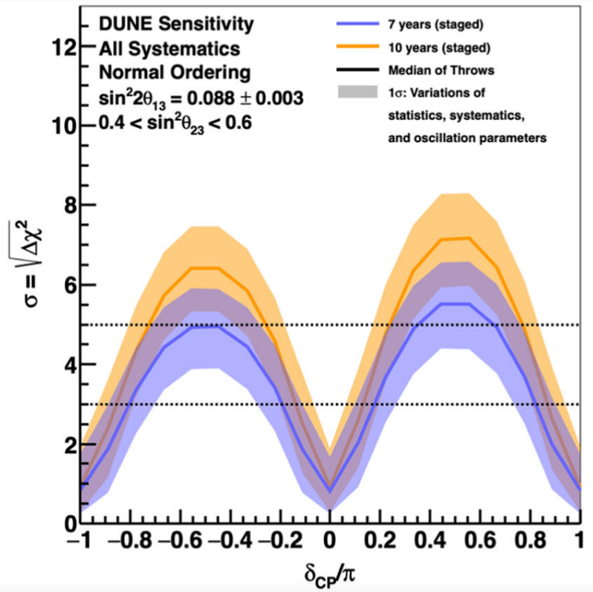
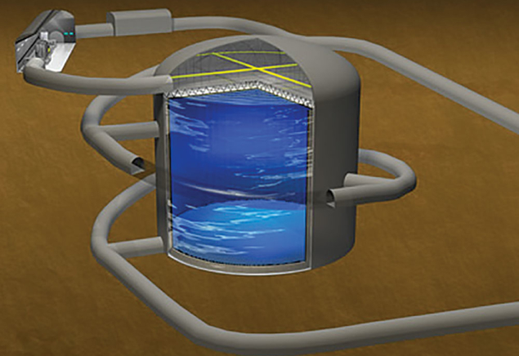
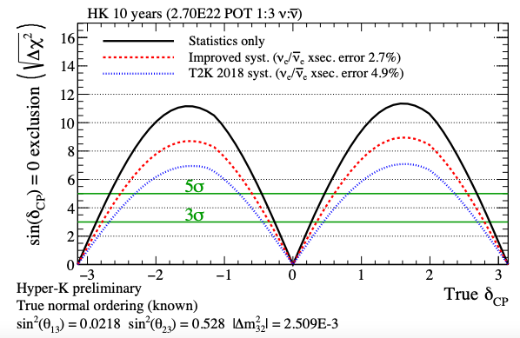
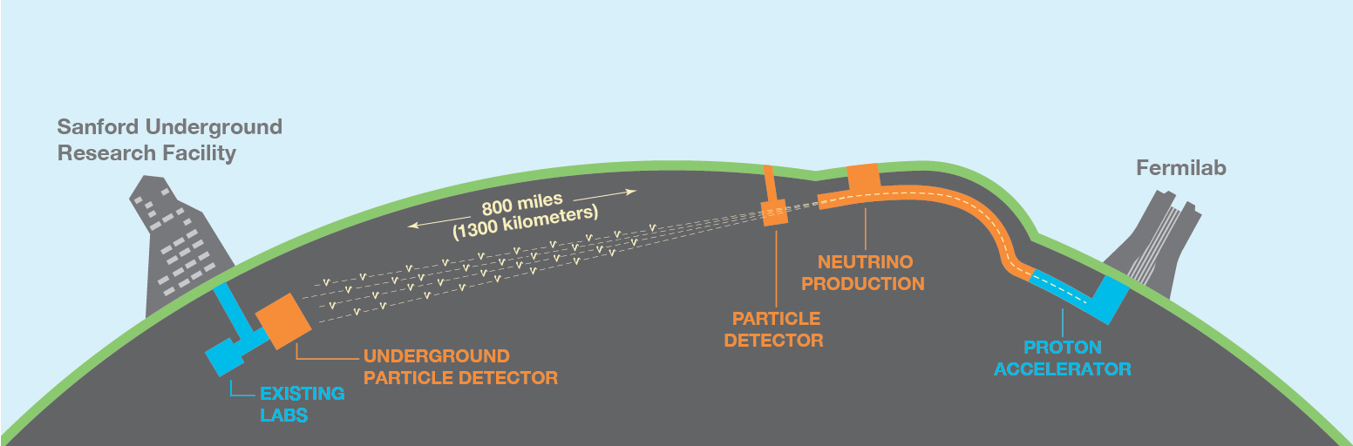
The future: Hyper-K and DUNE
DUNE and Hyper-K are next-generation long-baseline experiments to solve the remaining questions
CP violation sensitivity
* Target nuclei: argon
* Target nuclei: water
Eur.Phys.J.C 80 (2020) 10, 978
K.Sakashita (NuFact2021)
DUNE
Hyper-K
Notes:
We are expecting the next generation long-baseline accelerator neutrino experiments, DUNE and Hyper-K to give us definite answers.
For example, with much larger detector and more powerful beam, both experiments have a potential to establish CP violation at a high significance with a decade of data taking.

Slide 6
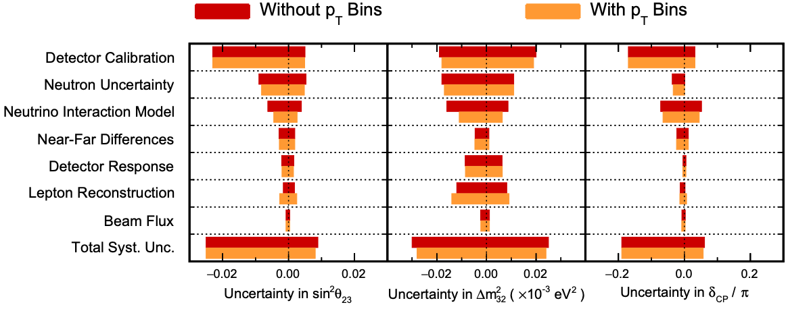
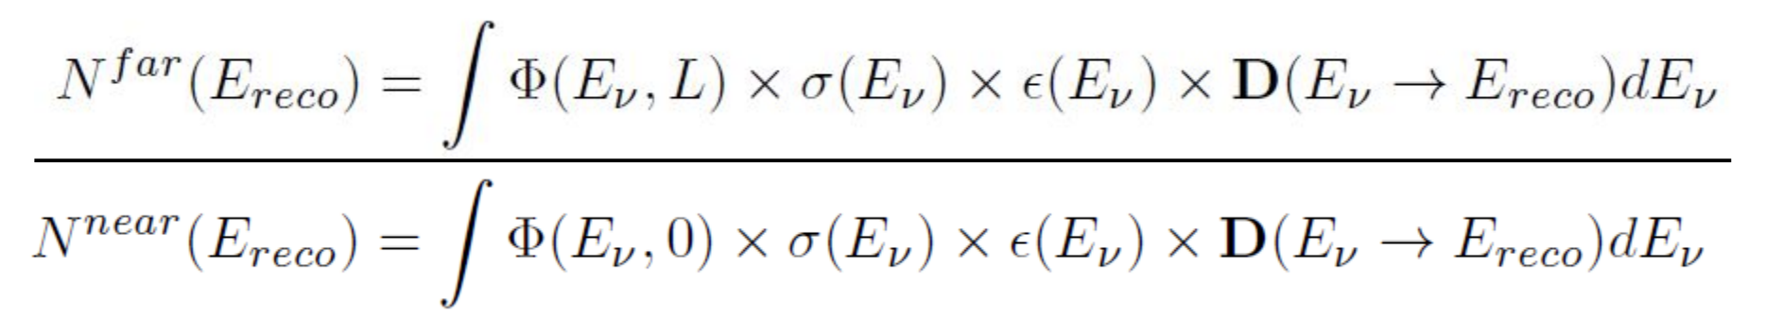
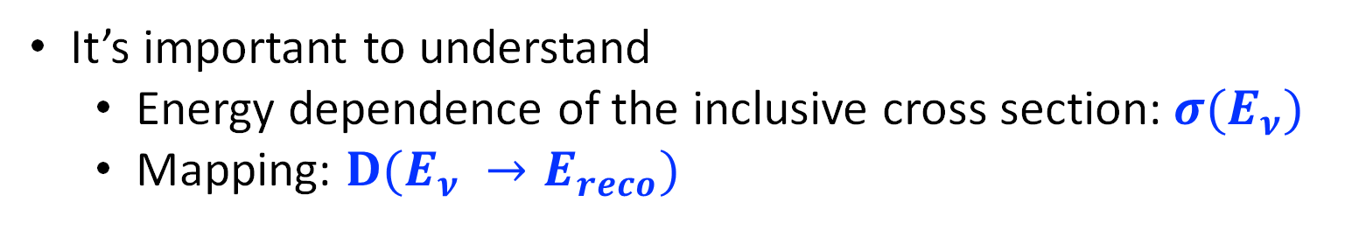
Systematic budget
Cross section uncertainty is the dominant for accelerator oscillation experiments
NOvA arXiv:2108.08219 (similar in T2K)
It’s important to understand
Energy dependence of the inclusive cross section: $σ(E_{ν})$
Mapping: ${D(E}_{ν} →E_{reco})$
focus of this talk
Notes:
While next-generation experiments will have more statistics, we also need to control the systematic uncertainties, since the measured number of events is a convolution of neutrino flux, neutrino cross section, and detector response.
As shown by the systematic budget from the NOvA experiment, the uncertainty of the neutrino interaction model is a dominant factor.
It’s contributing to both the energy-dependent cross section sigma(Enu) and the mapping between the true neutrino energy and the reconstructed neutrino energy D(Enu -> Ereco).
In this talk, I am going to focus on these two issues.

Slide 7
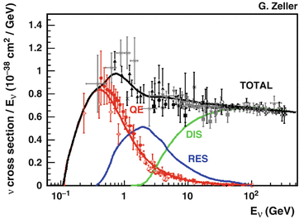
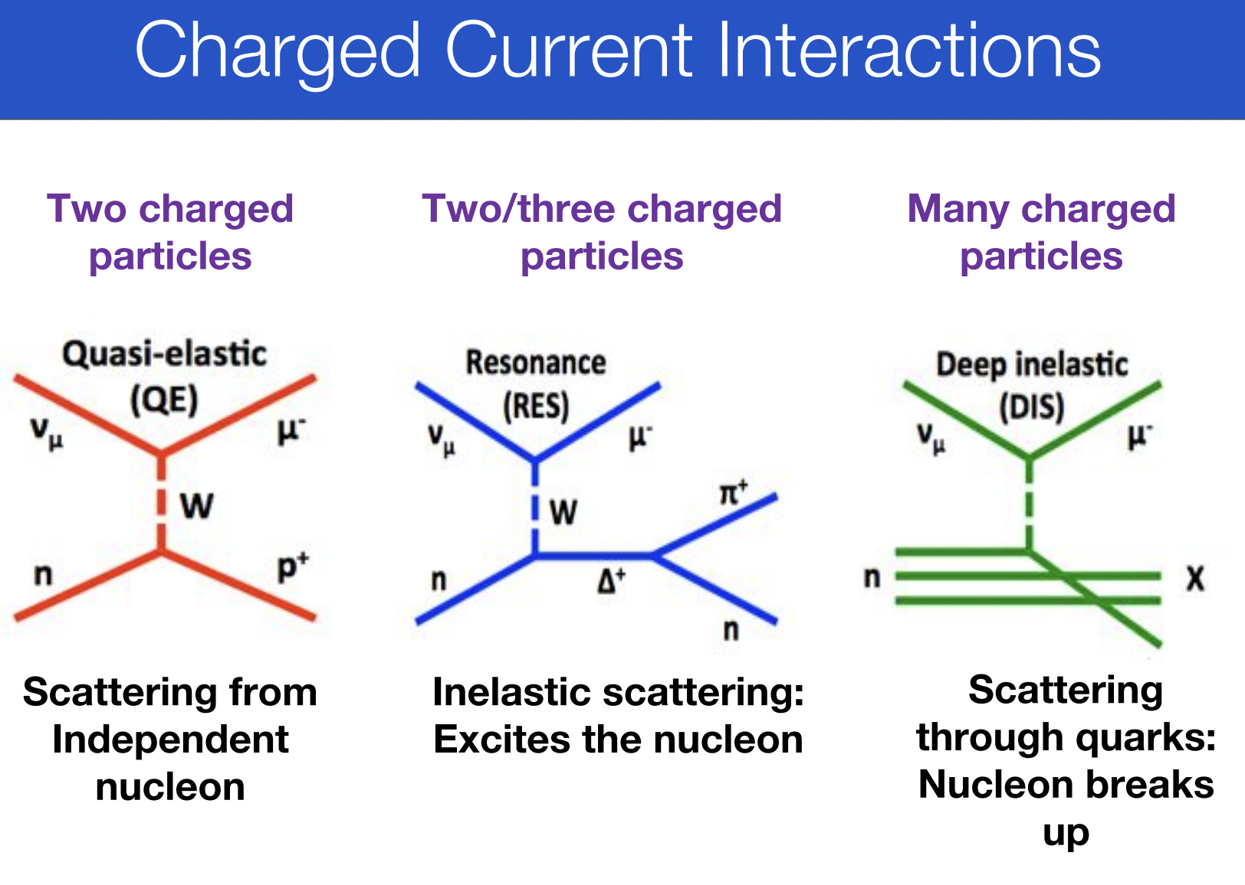
Charged-current (CC) interactions
Scattering off single nucleon
Inelastic scattering: Excites the nucleon
Breaks up nucleon
Charged-current neutrino-nucleus interaction is the major channel for oscillation experiments
Notes:
Now let’s dive into the microscopic neutrino interaction theory of the charged-current interaction a little bit.
At the energy below 1GeV, the Quasi-Elastic scattering is dominating the interaction, in which an incident neutrino scatters off a single nucleon with an outcoming lepton and a nucleon. When the neutrino energy is higher, the nucleon will be excited to resonant states.
When neutrino energy is even higher, the Deep Inelastic Scattering is taking place, in which partons inside the nucleon are interacting with neutrino instead.
These three interactions build a basic picture of neutrino’s interaction with nucleon.

Slide 8
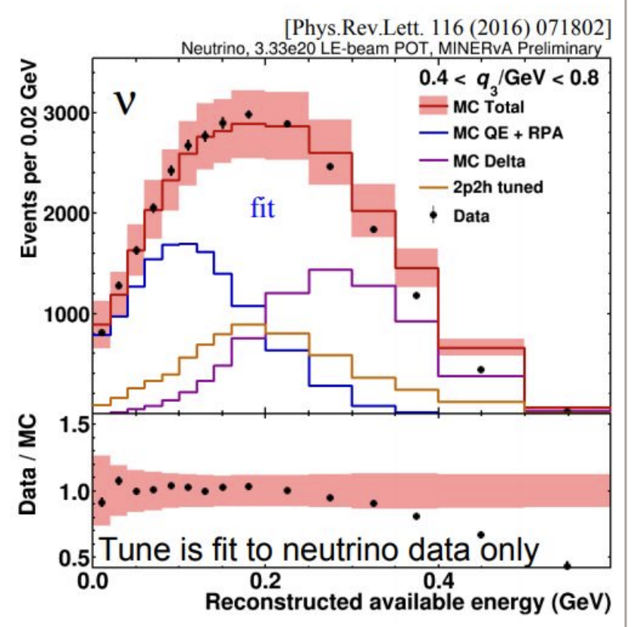
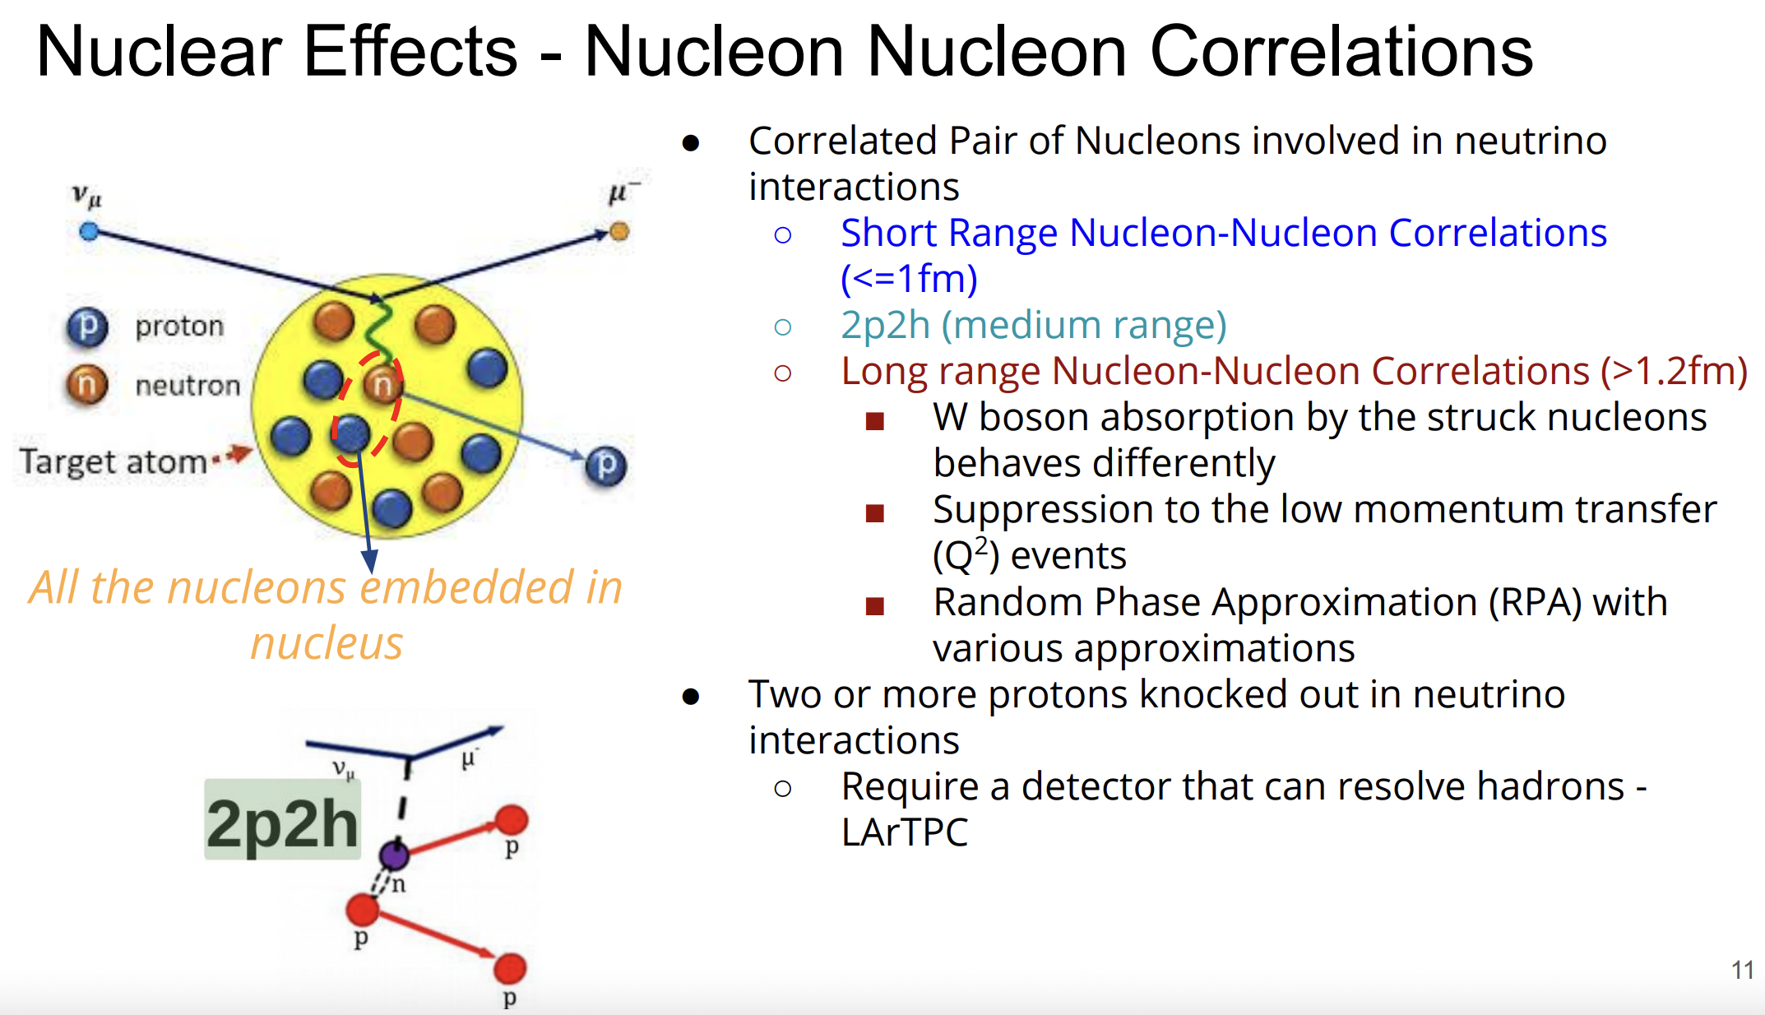
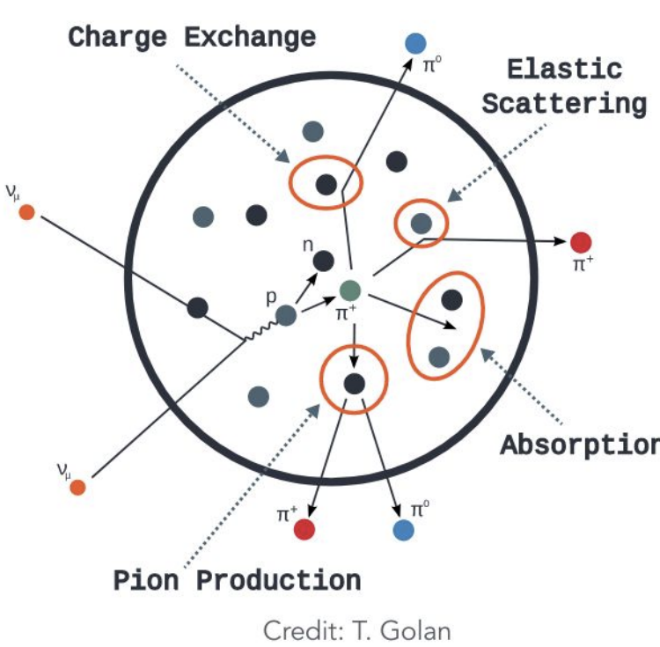
Nature is more complicated: nuclear effect
Even the ”simple” QE scattering is not so simple (2p2h, RPA, etc.)
Short range nucleon-nucleon correlations
2p2h (medium range)
Long range nucleon-nucleon correlations: suppression on low Q²
FSI
MINERvA
Notes:
Given that accelerator neutrino experiments typically utilize nucleus as target, the nuclear effect also comes into the picture.
Even for the seemingly ”simple” CCQE, nuclear effect involving nucleon-nucleon correlation are important to explain the existing measurements from Minerva, T2K and MiniBooNE.
At different scales, the correlation has different effects. At the medium range, it is modelled as a process called 2p2h, in which the neutrino is interacting with a pair of nucleons. In the long range, it leads to a suppression at low momentum transfer.
In addition, one needs to consider the final state interaction within the nucleus.

Slide 9
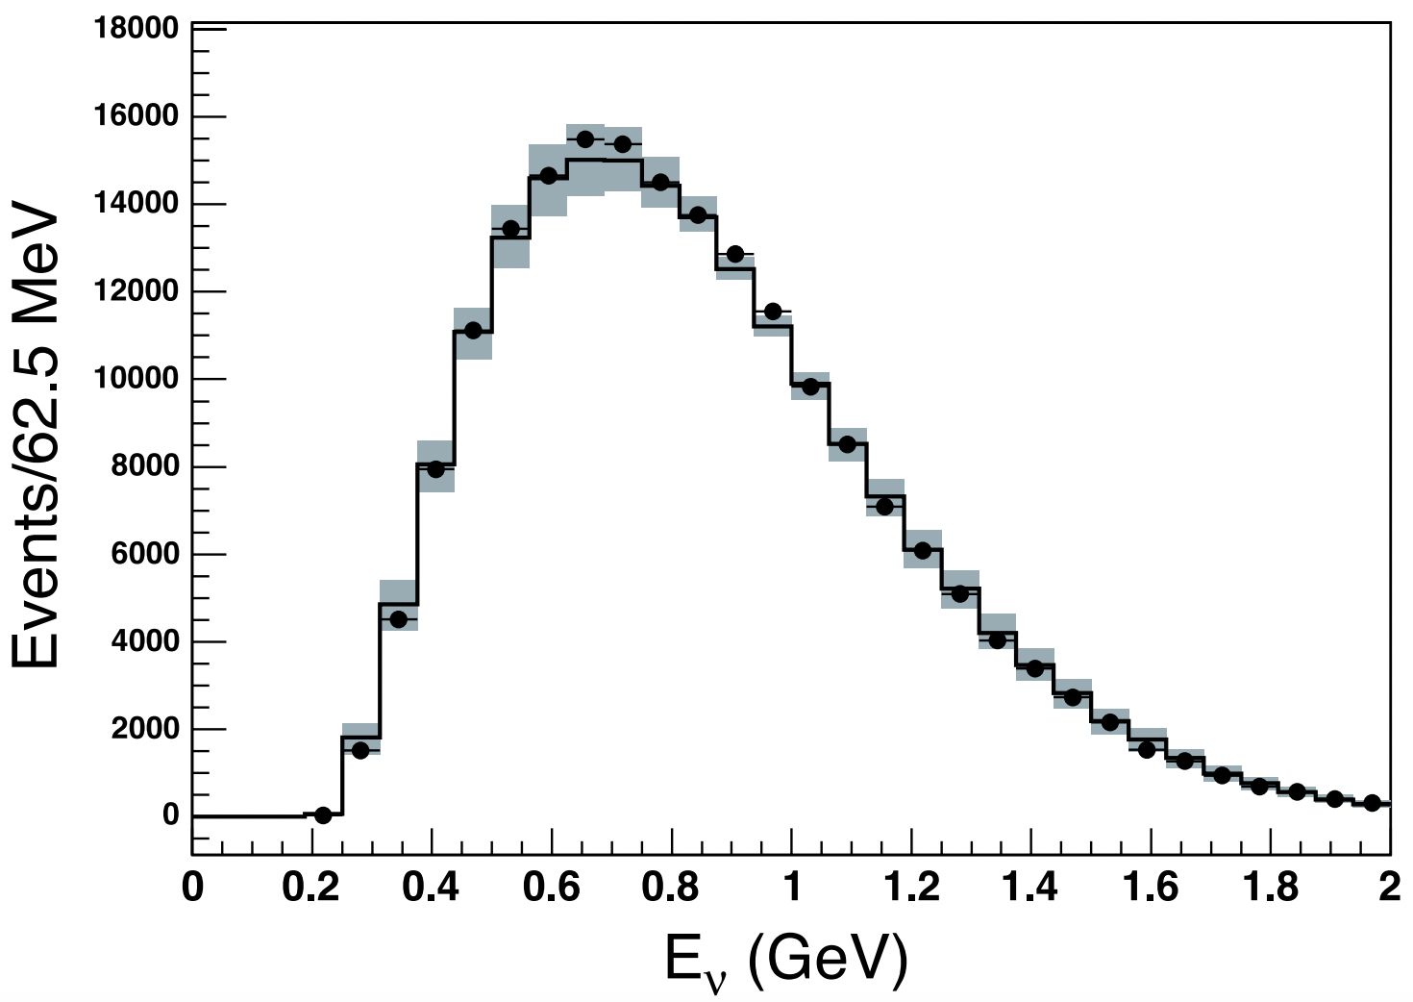
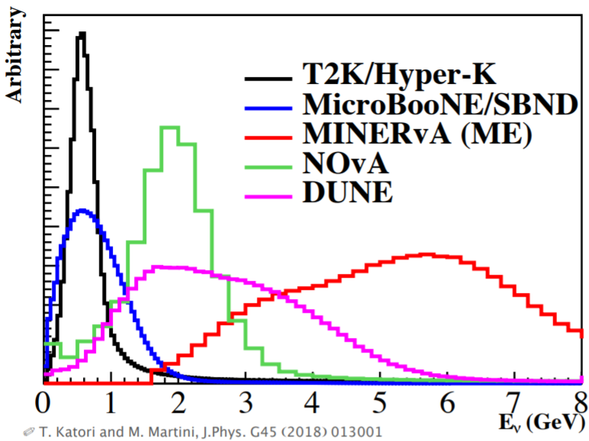
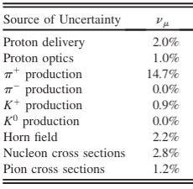
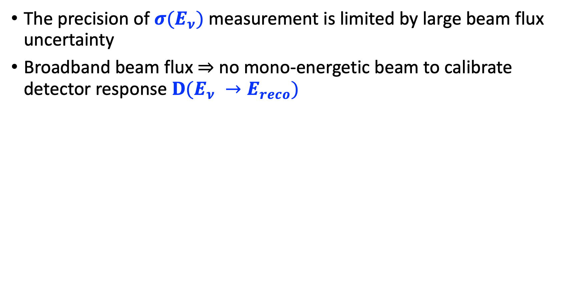
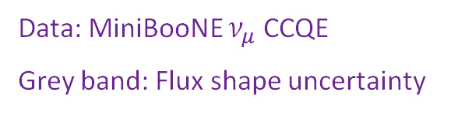
Difficulties from (broadband) beam
The precision of $σ(E_{ν})$ measurement is limited by large beam flux uncertainty
Broadband beam flux $⇒$ no mono-energetic beam to calibrate detector response ${D(E}_{ν} →E_{reco})$
Phys.Rev.D 79 (2009) 072002
Data: MiniBooNE $ν_{μ}$ CCQE
Grey band: Flux shape uncertainty
Notes:
The challenge of understanding neutrino nucleus interaction cross section is further complicated by the broadband neutrino beam in the experiments. First, the precision of the cross-section measurement is limited by the large beam flux uncertainty. Second, in the broadband beam, we do not know the neutrino energy at an event-by-event level, making it difficult to calibrate the mapping D(Enu->Ereco).

Slide 10
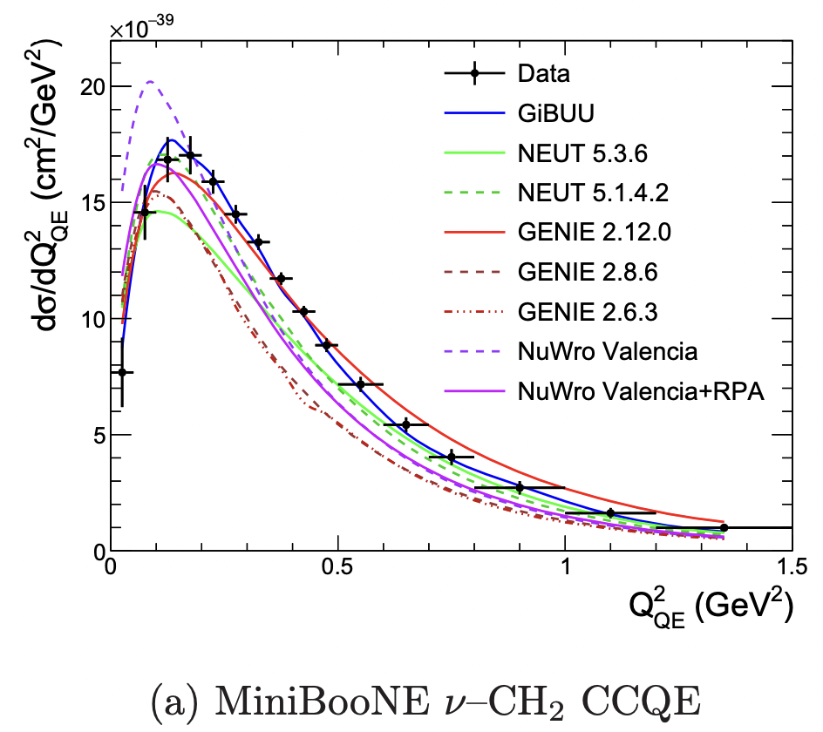
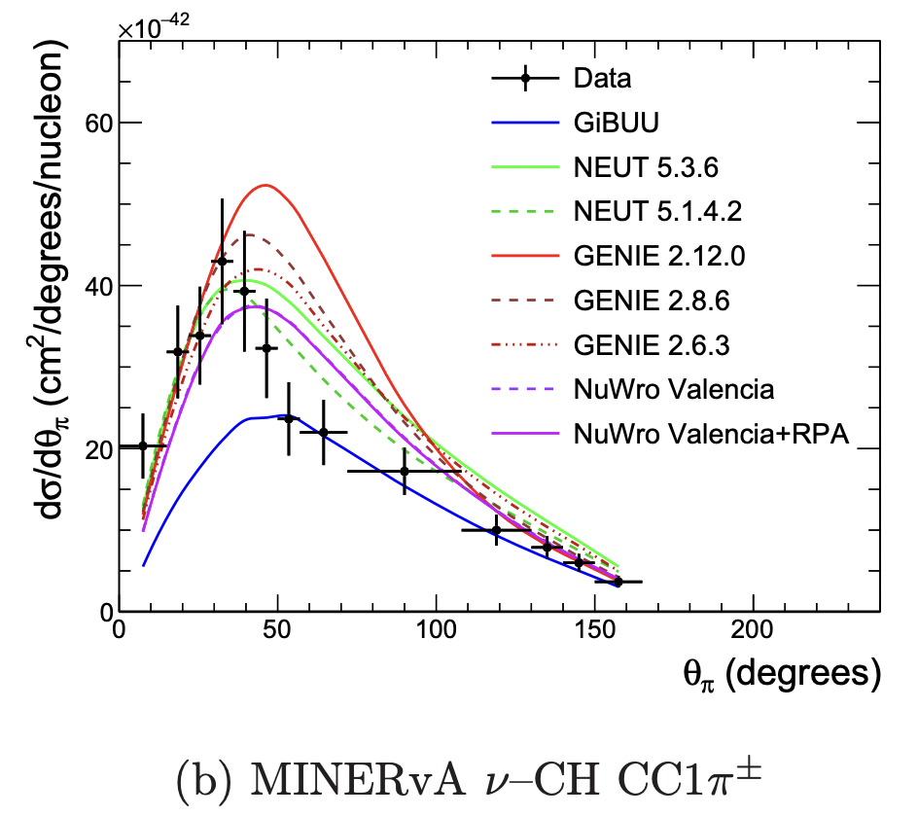
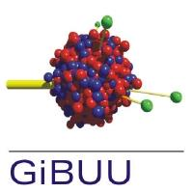


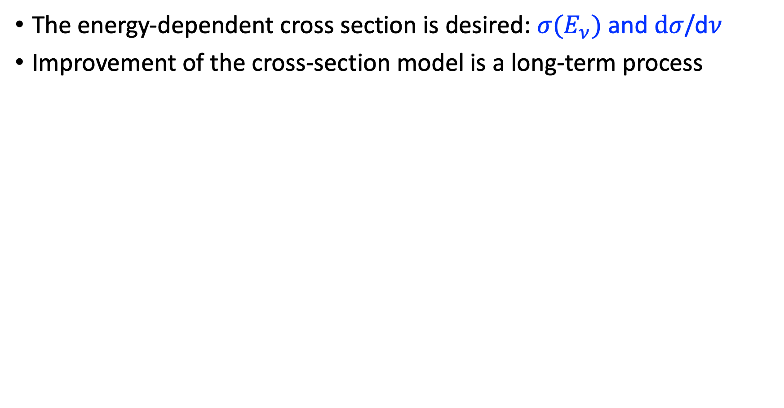
Cross-section measurements are important
The energy-dependent cross section is desired: $σ(E_{ν})$ and $dσ$/d$ν$
Improvement of the cross-section model is a long-term process
JINST 12 (2017) 01, P01016
NEUT
Notes:
Despite that the community has proposed the nuPRISM concept to solve the problem of the broadband beam issues and aim at model independent calibration of neutrino cross section, the practical constraint still likely require neutrino cross section models in the analysis.
So, I believe the cross-section measurements are still important to improve the neutrino cross section models. Given the complication of modeling the neutrino cross section, the improvement is likely a long-term process. A lot of progresses have been made by event generators with existing data, but we still need to do more.

Slide 11
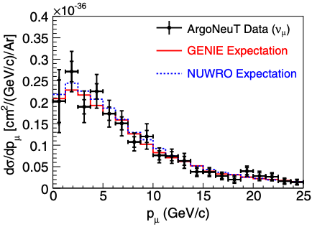
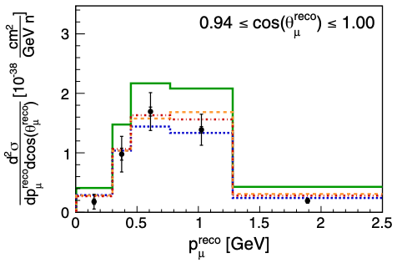
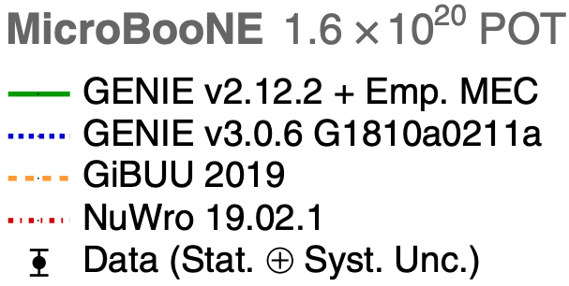
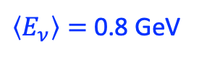

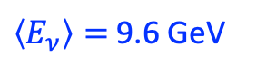
Inclusive $ν_{μ}$CC measurements
$\left\langle E_{ν}\right\rangle =$ 9.6 GeV
Modern accelerator-based neutrino experiments:
Experiment | Target | References
ArgoNeuT | Ar | Phys. Rev. Lett. 108 161802 Phys. Rev. D 89 112003
MicroBooNE | Ar | Phys. Rev. Lett. 123 131801
MINERvA | CH, C/CH, Fe/CH, Pb/CH | Phys. Rev. Lett. 112, 231801 Phys. Rev. D94, 112007 Phys. Rev. Lett. 116
MINOS | Fe | Phys. Rev. D81, 072002
NOMAD | C | Phys. Lett. B660, 19
SciBooNE | CH | Phys. Rev. D83, 12005
T2K | CH, H₂O, Fe | Phys. Rev. D87, 092003 Phys. Rev. D90, 052010 Phys. Rev. D93, 072002
$\left\langle E_{ν}\right\rangle =$ 0.8 GeV
Notes:
More inclusive measurements now using the the same nuclear targets as in the next-generation accelerator neutrino experiments are of utmost importance.
The table here summarizes the inclusive muon neutrino charged-current measurements from modern accelerator-based neutrino experiments.
For example, ArgoNeuT and MicroBooNE measured the differential cross sections on Argon at different neutrino beams, which are helpful for improving the cross section systematic uncertainties in DUNE.

Slide 12
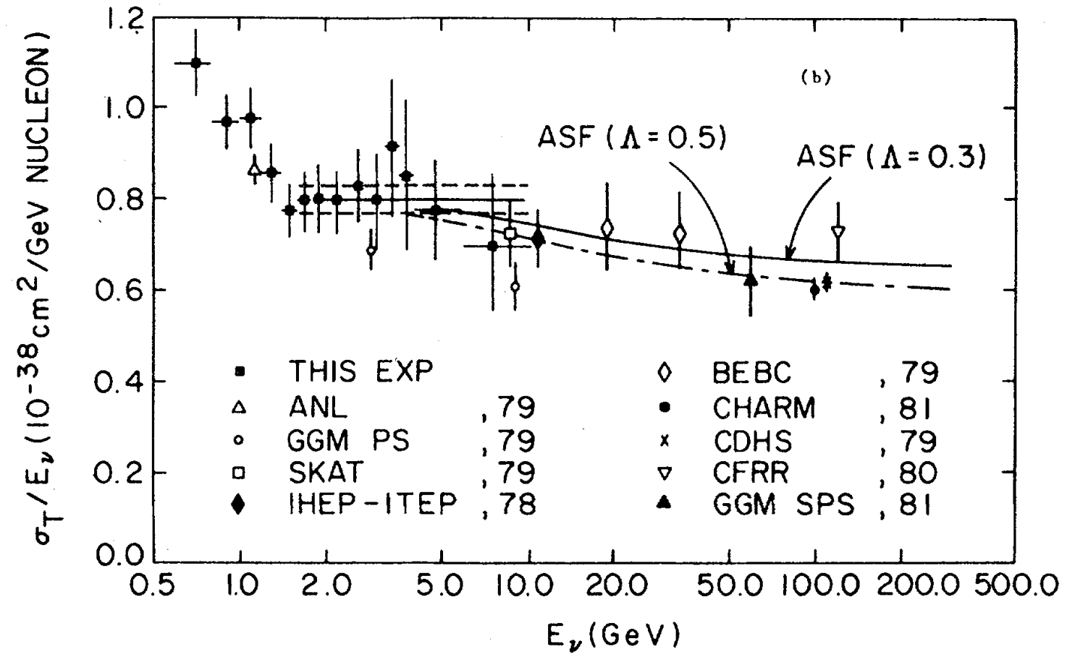
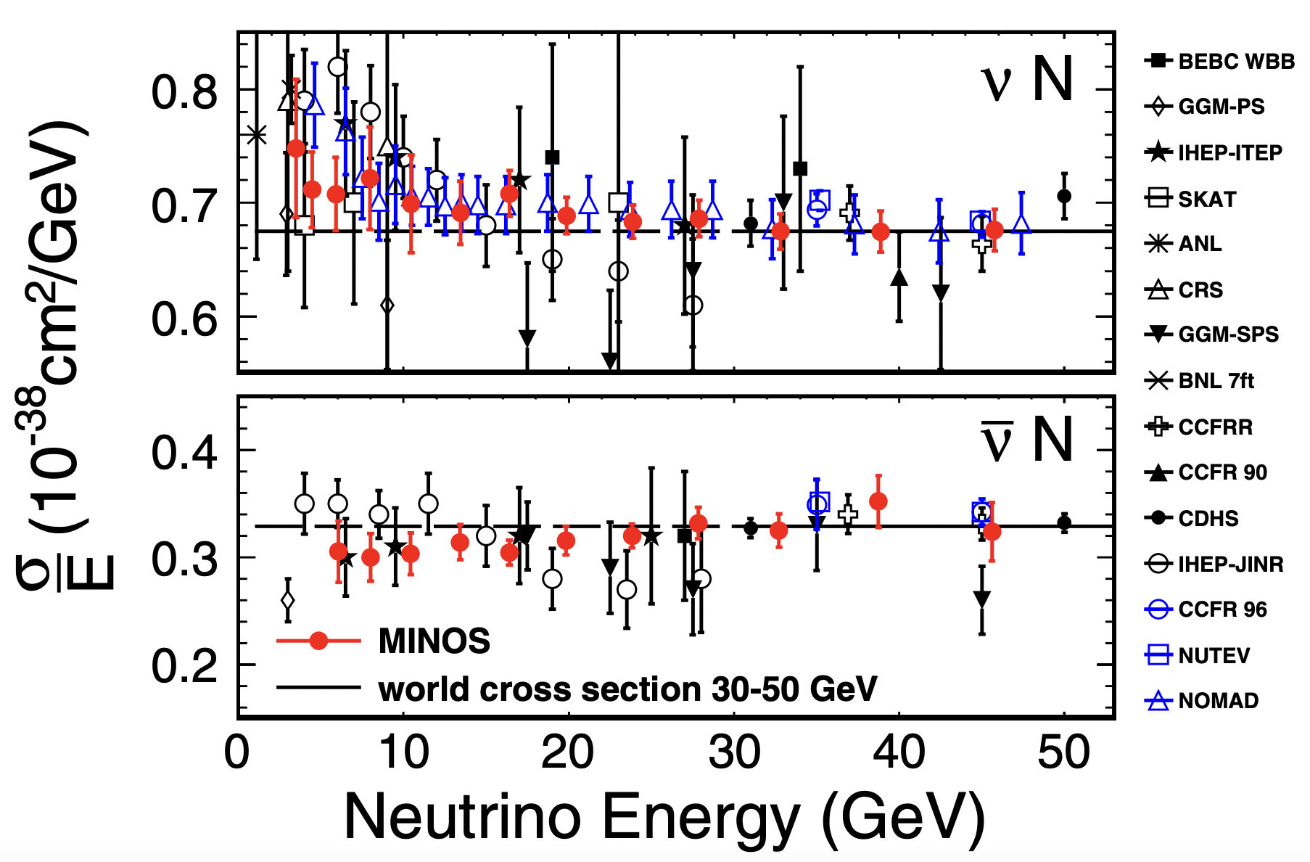
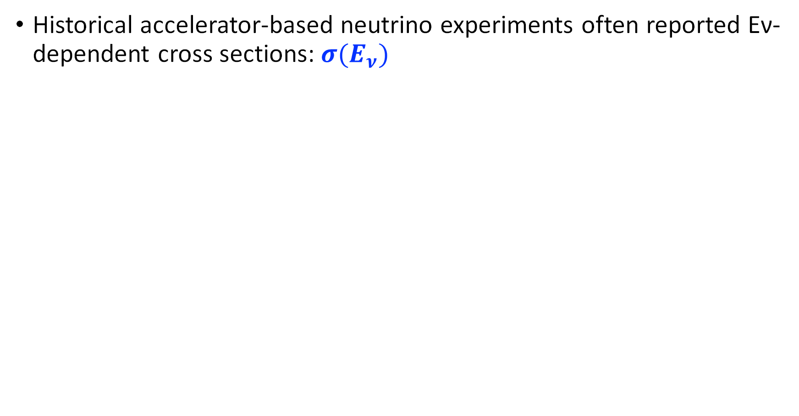
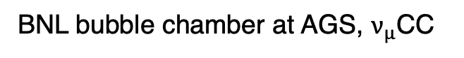
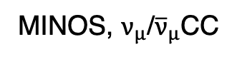
In the old days
Historical accelerator-based neutrino experiments often reported Eν-dependent cross sections: $σ(E_{ν})$
BNL bubble chamber at AGS, $ν_{μ}$CC
MINOS, $ν_{μ}$/${\overline{ν}}_{μ}$CC
Phys. Rev. D. 25 617
Phys.Rev.D81:072002,2010
Notes:
Now let’s briefly review the trend of neutrino cross section measurements. In the old days, experimental collaborations such as the BNL bubble chamber and MINOS often reported Ev-dependent cross sections.

Slide 13
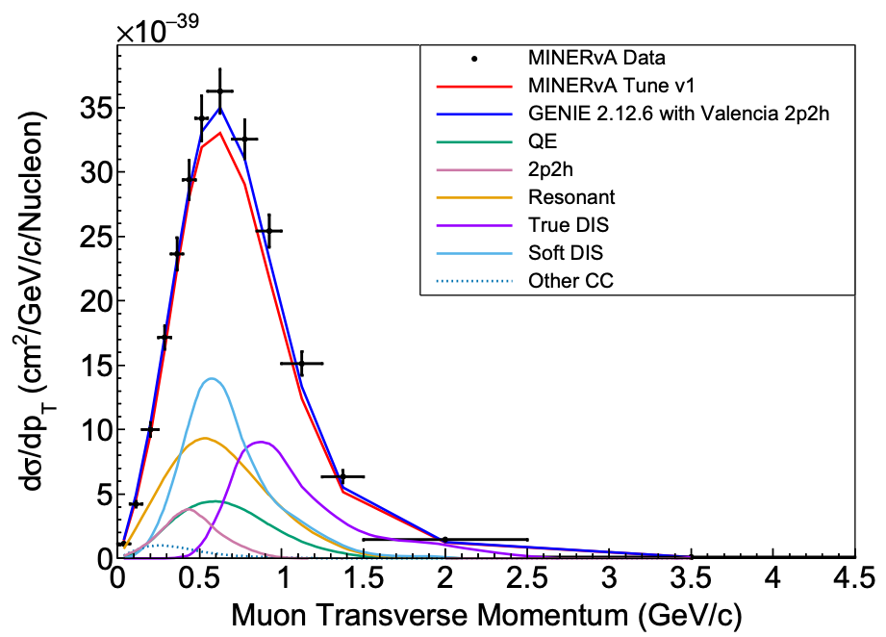
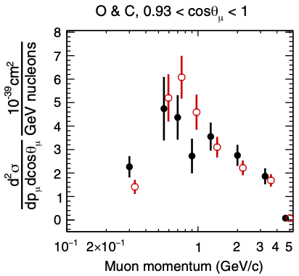
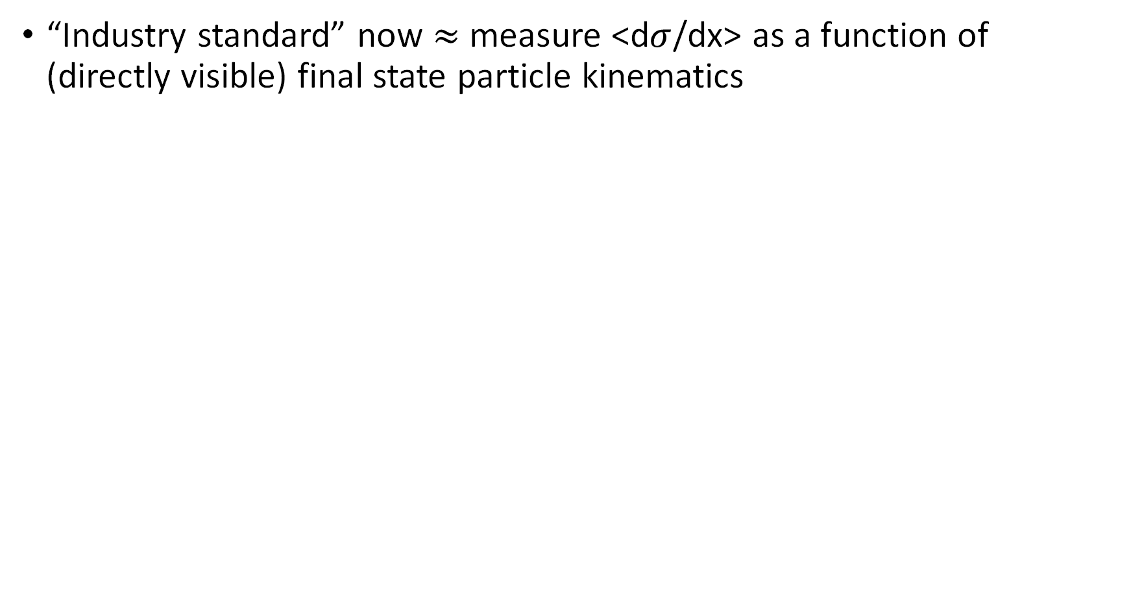
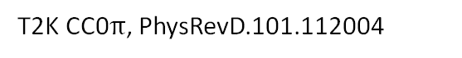
Recent years
“Industry standard” now $≈$ measure <d$σ$/dx> as a function of (directly visible) final state particle kinematics
MINERvA, arXiv:2106.16210
T2K CC0$π$, PhysRevD.101.112004
Notes:
In the recent years, experimental collaborations tend to report differential cross section as a function of directly visible final state particle kinemtics such as the muon momentum and muon angle. In this case, the broadband neutrino energy is integrated.

Slide 14
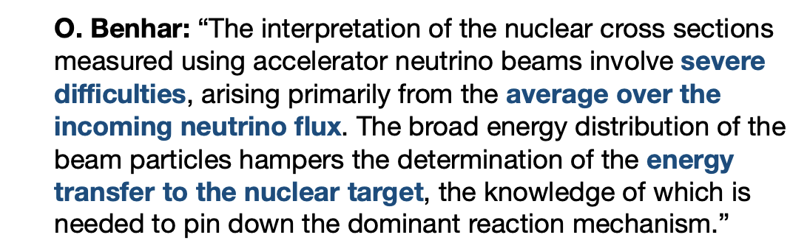
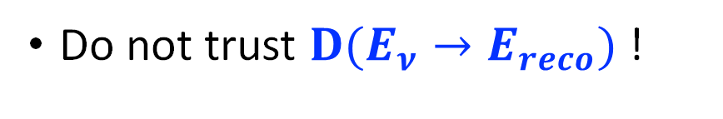
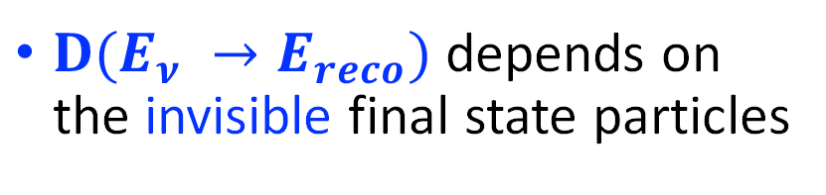

Why is there a shift in the “industry standard”?
However, the inclusive cross section $σ\left(E_{ν}\right)$ is essential for oscillation search
Do not trust ${D(E}_{ν}→E_{reco})$ !
$$N^{near}\left(E_{reco}\right)=∫Φ\left(E_{ν},0\right) × σ\left(E_{ν}\right) × ε\left(E_{ν}\right) × D\left(E_{ν}→E_{reco}\right) dE_{ν}$$
${D(E}_{ν} →E_{reco})$depends on the invisible final state particles
Notes:
The reason for this shift in the industry standard is because people do not trust D(Enu->Ereco) because it depends on the invisible final state particles. And of course, as we introduced earlier, D(Enu->Ereco) is crucial to the accelerator neutrino oscillation experiment.
This shift in the industry standard also creates severe difficulties in the interpretation of the nuclear cross section measurements. The integration of the broadband neutrino beam often mixes many effects together, making it difficult to pin down the specific interaction mechanism.
--- (in the other word, if one observe data-MC discrepancy, we don’t know if it’s due to CCQE, RPA or RES).

Slide 15





Inclusive $ν_{μ}$CC cross section on argon from MicroBooNE
Validate ${D(E}_{ν} →E_{reco})$
Measure $σ(E_{ν})$
2
Good basis for the study of various exclusive interaction processes
Important for improving $ν$-Ar cross-section model in DUNE
Notes:
In this talk, I am going to report a new validation of D(Enu->Ereco) and the measurement of the Inclusive $ν_{μ}$CC cross section on argon from MicroBooNE. This measurement forms a good basis for the study of various exclusive interaction processes. With the same argon target, this work is also important for improving the $ν$-Ar cross-section model in DUNE.

Slide 16

the Micro Booster Neutrino Experiment (MicroBooNE)
180 collaborators, 36 institutions, 5 countries
Notes:
MicroBooNE is a collaboration at Fermilab with about 180 collaborators from 36 institutions of 5 countries.

Slide 17



MicroBooNE Detector: An 85-ton LArTPC
8192 wires
Notes:
The center of the MicroBooNE detector is an 85-ton LArTPC, about the size of a school bus. It is about 2.3 meter high, 2.5 meter wide and 10.4 m long.
The charge readout consists of three wire planes with 8192 wires.
A Light collection system, consisting of 32 PMTs, are used to detect the scintillation light to determine the event time.

Slide 18


Principle of Single-Phase LArTPC
Made by Bo Yu (BNL)
time
PMTs detect the scintillation light, time ~ns
Drift velocity 1.1 mm/μs → several ms drift time
Notes:
LArTPC is a tracking calorimeter. When charged particles transverse through the Liquid Argon medium, the ionized electrons will travel at a constant speed to the anode plane following the external electric field.
A position sensitive detector, such as, wire planes with O(mm) position resolution at different orientations, can determine the position at the plane perpendicular to the electric field. The time between the event time, which is determined by the detection of scintillation light, and the electron’s arrival time at anode plane provides the position information along the electric field.
This allows a reconstruction of 3D image of a neutrino-argon interaction.

Slide 19
Liquid Argon Time Projection Chamber (LArTPC)
Protons
Delta-ray
Pion?
LArTPC: fully active tracking calorimeter
DUNE’s first choice
Two EM showers from pion decay gammas
Vertex of neutrino interaction
Beam
Drift
* A candidate of neutral-current interaction
Notes:
In the LArTPC, particle identification can be done with energy deposition, represented by the colors in the plot, and the topology information. Here is a candidate of neutral-current interaction from MicroBooNE. You can see two EM showers from neutral pion decay in addition to a few proton and charged pion tracks.

Slide 20

Fermilab
Notes:
Here is a landscape of Fermi National Laboratory in Chicago.

Slide 21


Booster Neutrino Beamline
BNB @ MicroBooNE
Mean Neutrino Energy 0.8 GeV
Over 99% ν_{µ}/ν_{µ}
~0.5% intrinsic ν_{e}
-
468.5 m
Notes:
MicroBooNE experiment locates at the Booster Neutrino Beamline, where 8-GeV protons are bombarded on a Be target to produce neutrinos.
The mean energy of the neutrino beam is about 0.8 GeV.
About 94% of the neutrinos are muon neutrino.

Slide 22


Booster Neutrino Beamline
MicroBooNE detector being lowered into LArTF
-
MiniBooNE LEE
~70 m
Notes:
The location of the MicroBooNE detector is very close to that of MiniBooNE detector with about 70 m distance.
The primary physics goal of MicroBooNE is to understand the nature of MiniBooNE low energy excess.

Slide 23






Address MiniBooNE LEE
Xin Qian’s colloquium on Oct 28
Xiangpan Ji’s seminar on Oct 29
MiniBooNE ”low-energy excess”
BNB $18.75×{10}^{20}$ POT
(2002-2019)
MicroBooNE eLEE result
arXiv:2110.14054
$4.8σ$ Excess
Phys. Rev. D 103, 052002
MicroBooNE do not observe LEE under a $ν_{e}$ hypothesis
Also, do not observe an enhancement of NC $Δ→Nγ$
MicroBooNE gLEE result
arXiv:2110.00409
Notes:
A few weeks ago, my colleagues Xin and Xiangpan gave local colloquium and seminar. They reported our first LEE search result. We did not observe and excess of electron neutrino at low energy. And we also did not observe an enhance of the NC delta radioactive decays.

Slide 24


MicroBooNE Goals
Same neutrino beamline and roughly same location as MiniBooNE
Unique $e/γ$ separation capability
Address MiniBooNE LEE
Study $ν$-Ar interactions
LArTPC hardware & software R&D
LArTPC design, cryostat, cold electronics ...
Noise filtering, TPC signal processing, detector physics, event reconstruction
First large-scale LArTPC constructed in the US; longest-running
Notes:
Beside the primary physics goal, the MicroBooNE experiment is also important to perform hardware and software R&D in developing LArTPC for next generation accelerator experiments. Being the first large scale LArTPC constructed in the US, it can also provide first data to study neutrino-argon interactions.

Slide 25











LArTPC R&D
JINST 15 P07010 (2020)
JINST 15 P12037 (2020)
JINST 12 P08003 (2017)
JINST 13 P07006 (2018)
JINST 13 P07007 (2018)
Space charge effect: distortion of drift E field and reco charge position
Noise filtering
2D signal processing
JINST 12 P10010 (2017)
Good understanding of detector response which is as well incorporated in the overlay MC simulation (noise and cosmic muons from off-beam data overlaid with neutrino simulation).
Ionization electron longitudinal diffusion
Muon momentum
arXiv:2104.06551
JINST 12 P09014 (2017)
Position-dependent dQ/dx calibration and effective recombination model
Cosmic muon reco
Michele electron
JINST 15 P03022 (2020)
JINST 12 P12030 (2017)
Notes:
The MicroBooNE has gained a good understanding of the detector response, providing a solid foundation for high-level reconstruction and physics analysis.
For example, the noise filtering and advanced 2D signal processing, the in-situ measurement of the drift electric field which is distorted by the space charge effect,
the data-driven calibration of recombination effect and position-dependent wire response due to imperfect detector instrumentation, measurement of ionization charge diffusion,
and other energy or reconstruction calibration using cosmic-ray muons or Michele electrons.
This knowledge is incorporated in the overlay MC simulation.

Slide 26










Highlights of MicroBooNE’s $ν$-Ar interaction studies
$ν_{μ }$CC inclusive double differential xsec
Phys. Rev. Lett. 123, 131801
High-statistics examination of $ν−Ar$ cross section model
Phys. Rev. D 102, 112013
Phys Rev Lett. 125, 201803
Phys. Rev. D 104, 052002 (2021)
$ν_{μ }$CC0$π$ differential xsec as a function of muon polar angle
$ν_{μ }$CC1p0$π$ differential xsec
$ν_{e }/{\overline{ν}}_{e}$ CC inclusive total xsec
Notes:
Prior to this work, we have also reported inclusive and exclusive differential cross sections as a function of kinematics of visible final state particles such as muon or proton.
There is no neutrino energy-dependent measurement, as mentioned, this is the recent trend in this field.
In this work, we tackled the challenge of measuring neutrino-energy dependent cross sections.

Slide 27



Challenge for MicroBooNE’s $ν$ studies
Cosmic-ray muon background rejection
1 $ν$ interaction per 600 beam spills
Near surface operation of LArTPC (slow readout detector) leads to 20-30 cosmic muons per trigger
Event reconstruction
Pattern recognition given complicated event topology: Tracks, showers, decays
 | BNB | NuMI
Primary proton | 8GeV | 120GeV
Power | 30kW | 700kW
Target | Beryllium | Carbon
Notes:
A major challenge for MicroBooNE’s cross section measurement is the vast amount of cosmic-ray muon background. Limited by the BNB beam power, we have in average 1 neutrino interaction every 600 triggers. With a LArTPC operated near surface, each trigger contains 20-30 cosmic-ray muon background.
Another major challenge is the event reconstruction. Excellent pattern recognition is required to deal with complicated event topologies in event selection and energy reconstruction.

Slide 28





Wire-Cell reconstruction chain
https://lar.bnl.gov/wire-cell/
3D Pattern Recognition
Cosmic Ray Removal
arXiv:2110.13961
Phys. Rev. Applied 15, 064071
JINST 16 P06043
(MicroBooNE imaging, clustering, matching)
3D imaging principle
Event Taggers
arxiv:2110.13978
Notes:
These two challenges were solved by the WireCell reconstruction tools. This slide shows the major building blocks of the WC reco. chain.
Based on the improved simulation, noise filtering and signal processing, the topology agnostic 3D tomographic imaging and clustering are achieved.
In addition, the cluster charge-PMT light matching as well as other cosmic-ray muon background rejection tools are applied.
The 3D pattern recognition is further applied to reconstruct the interaction vertex, particle ID and flow, as well as the energy reconstruction.
The pattern recognition information is feed to a BDT tagger to identify neutrino candidates.

Slide 29



Cluster-flash (charge-light) matching
20-30 clusters / event
40-50 PMT flashes / event
Can we find the $ν$ cluster in coin. with beam flash?
$$⇔$$
The key problem to reject cosmic-ray muon is to find the correct T₀ (light info.) to the corresponding TPC cluster
Given the light and charge readout are decoupled, the matching becomes a combinatorial problem
We solved the problem with compressed sensing!
Notes:
A key technique to overcome the cosmic-ray muon background is the charge-light matching. Given the light and charge readout are decoupled, the matching becomes a combinatorial problem. We solved the problem with compressed sensing.

Slide 30

Notes:
Note that our charge-light matching technique is a many-to-many matching algorithm.
We can correctly match almost all the TPC clusters with their associated PMT flashes.
The red dots are the measured PMT charge pattern, while the green ones are the predicted charges given the matched cluster.

Slide 31




Before and After Flash Matching
Side view
Top view
Front view
CC ν_{μ} candidate
Notes:
After applying the coincidence between the beam timing and the flash time, we can select neutrino interaction candidates.

Slide 32


Rejecting Through-Going Muons (TGM)
Only event with flash(light) time matching the neutrino beam spill window is a neutrino candidate
Y
TGM: cosmic-ray muons go all way through the active TPC volume
Z (beam direction)
Identification: the two endpoints of TPC cluster at/outside the effective detector boundary
Effective detector boundary because of space charge effect
Neutrino:Cosmic-ray
Charge-light matching
1 : 6.4
Fiducial volume used in analysis: 3 cm inside the effective boundary
Improved by factor of 6
TGM rejection
1 : 0.9
Notes:
After charge-light matching, the remaining background is the random coincident cosmic-ray muon. The through-going muon can be rejected by identifying the entering and exiting points. A one-to-one signal to background ratio can be achieved.

Slide 33


Rejecting Stopping Muons
STM: cosmic-ray muons enter and stop inside the active volume
Y
Identified by directionality: from outside to inside
Trajectory and dQ/dx fitting → Bragg peak → directionality
X (drift direction)
Neutrino:Cosmic-ray
Charge-light matching
1 : 6.4
Improved by factor of >6
TGM rejection
1 : 0.91
Improved by factor of ~3
STM rejection
1 : 0.36
Additional Cuts
1 : 0.20
Notes:
The next major background is the random coincident cosmic-ray muon entering and stopped inside the detector. This is the major background for the charged-current numu interaction with a single muon in the final state. The difference between the signal and background is the directionality, while signal muon is originated from inside TPC and going out, the background muon is entering into the TPC. The directionality of the muon can be determined by searching for the Bragg peak near the candidate stopping point. In the end, we achieved a 5 to 1 S/B ratio.

Slide 34



Wire-Cell 3D pattern recognition
arXiv:2110.13961
Selected TPC activity is further constructed in particle flow
Deep learning method used to improve the neutrino vertex identification
Notes:
After the rejection of cosmic-ray background, we further applied the Wire-Cell 3D pattern recognition to reconstruct particle flow

Slide 35











Further $ν_{μ}$ CC selection through box cuts
Remaining backgrounds from the preselection
Cosmic-ray muon with imprecise charge-light matching
$ν_{μ}$ neutral-current (NC) interaction
Neutrino interaction outside the fiducial volume
“generic-$ν$” preselection
Scaled to 5×10¹⁹ POT
① muon enters
$⇒$ reject with FV cut
② charged hadron enters
$⇒$ reject with direction of muon product
CC/NC selection
$⇒$ separation of charged $π$ and $μ$
Mimicking an exiting single muon
$⇒$ reject with vertical direction
TGM incorrect light matching
“charged-$π$ like”: large angle scattering
$ν$ interaction outside FV
Phys. Rev. Applied 15, 064071 (2021)
Notes:
The reconstructed particle flow information can be further used to select numu CC and reject the remaining backgrounds, which are mainly from the cosmic-ray muons because of the imprecise charge-light matching, the neutral-current interaction, the neutrino interaction outside the fiducial volume.
(animation) For example, an incorrectly flash-matched TGM can mimic an exiting single muon.
(animation) For a neutrino interaction outside the FV, the entering muon can be rejected by applying a FV on the neutrino vertex. When charged hadrons enters the FV, the interaction vertex is often reconstructed at the muon product. In such case, the muon are often backward and can be rejected with a angular cut.
(animation) The primary separation of NC and CC interactions relies on the identification of the charged pion and muon. Charged pion tends to have large-angle scattering.

Slide 36




$ν_{μ}$ CC selection through XGBoost BDT
interaction-level variable
particle-level variable
Human feature engineering
+
Machine learning algorithm:
XGBOOST: extreme Gradient Boosting
Notes:
To further improve the numuCC selection, we also implemented the human-engineered box cuts in a machine learning algorithm based on boosted decision tree. The efficiency and purity can be estimated with the MC sample, while a similar efficiency is maintained, a higher purity is achieved.

Slide 37






Neutrino Energy Reconstruction
arXiv:2110.13961
Calorimetry energy reconstruction with particle mass and binding energy included if the PID is done
Track: Range, dQ/dx → dE/dx correction
Calibrated by stopped muons/protons
EM shower: scaling of charge
Calibrated by π⁰ invariance mass: CC and NC
Fully contained $ν_{μ}$CC
15-20% resolution ~10% bias
Fully contained $ν_{μ}$CC
Notes:
In terms of the neutrino energy reconstruction, a calorimetry reconstruction is adopted by considering the particle mass and binding energy for the hadron final state particles.
For tracks, the energies are estimated using the total track length or each step’s energy deposition along the track.
For EM showers, the total charges are scaled with a calibration of the pi0 invariance mass.
The final performance for the fully contained numuCC events is about 10-15% resolution and about 10% bias in the energy reconstruction.

Slide 38






Selection of Inclusive Charged-Current $ν_{μ}$ Interactions
 | Efficiency | Purity | Cosmic-$μ$ rejection
Trigger | 1 | 5e-5 | 1
Cosmic-ray rejection | 80% | 65% | 7e-6
$ν_{μ}$CC with pattern recognition (Fully & Partially Contained) | 68% | 92% | 7e-7
arXiv: 2110.14023
MC: GENIE v3 tune
Achieved excellent cosmic-$μ$ rejection
Wire-Cell reconstruction: JINST 16 (2021) 06, P06043
Cosmic-ray rejection:
arXiv:2012.07928, Phys. Rev. Applied 15, 064071 (2021)
The high-statistics event selection allows for high-precision/multi-dimensional cross-section measurements
Calorimetric energy:
$$E_{ν}^{rec}=E_{μ}^{rec}+E_{had}^{rec}$$
Notes:
In summary, compared to the trigger level, the cosmic-ray rejection achieved 7e-6 at 80% efficiency for numuCC. The application of further pattern recognition improved cosmic –ray muon rejection by another factor of 10, making it negligible. The final efficiency is 68% with purity at 92%. This high-performance event selection enabled a high-precision cross section measurement.
The plot shows the reconstructed energy distribution for the fully contained $ν_{μ}$ CC candidates, overlayed with the MC prediction.
---
For the data excess, it’s indeed due to xs.
0p vs NP: not flux issue
not energy shift: high energy component can not compensate low energy area. I will give you similar data-MC comparison in the other kinematics.
it’s expected since our MicroBooNE tune Xs model is tuned to T2K carbon data, the nuclear effect is more complicated in argon, it’s expected to have a difference
but all the difference has been sufficiently covered by the systematic uncertainty

Slide 39



Improvement w.r.t previous work
Scaled to 5.3E19 POT
 | Phys. Rev. Lett. 123, 131801 (2019) | This work
Expected # of true $ν_{μ}$ CC | 4541 | 10605
Efficiency* | 57.2% | 68%
Purity | 50.4% | 92%
This work
*: definition of efficiency is slightly different
muon polar angle: key variable for background rejection
$⇒$ confirms inclusive $ν_{μ}$CC selection
Notes:
This work represents a significant improvement for the inclusive $ν_{μ}$ CC selection in both the efficiency and purity, particularly for the $ν_{μ}$ CC interaction with a single muon.
---
For CCMEC, the reduction of efficiency at the backward angle may be attributed to the events with invisible protons in the final states, in which case a single backward-going muon will be more likely attributed tagged as cosmic-rays.

Slide 40





Neutrino interaction model and tune
arXiv: 2110.14028
Developed interaction model based on GENIE v3
Fit to 2016 T2K’s C₈H₈ ν_{μ} CC0π data at similar beam energy
4 key parameters: tune CCQE and 2p2h models
No additional fit to MicroBooNE data
T2K data: Phys Rev D. 93, 112012
$dσ^{2}$/${dP}_{μ}d\cos_{θ}$
arXiv: 2110.14028
$P_{μ}$ (GeV/c)
Before tuning
After Tuning
Notes:
Besides of an improved event selection, at MicroBooNE, we also developed our own neutrino interaction model based on GENIE v3, together with a fit to the T2K numuCC 0pi data at a similar energy range.
Four key parameters related to CCQE axial mass, RPA suppression and 2p2h are determined.
---
What’s the improvement in GENIE v3 – CCQE Ma & RPA, 2p2h normalization and shape
No use of MicroBooNE data is to avoid any potential bias from double-fitting to the MicroBooNE subsequent analysis

Slide 41

How to estimate systematic uncertainties?
Full systematic covariance
$$Σ^{syst}=Σ^{flux}+Σ^{xsec}+Σ^{det}+…$$
Multisim
Unisim
 | Multisim | Unisim
# of parameter variation at a time | Many | One
Parameter(s) variation | Random | Exactly 1$σ$
# of MC run | One | Many (one per parameter)
Technical treatment | Event reweighting | Bootstrapping
Notes:
To properly estimate the systematic covariance matrix from different modeling, two different types of treatments are used.
“Multisim” allows various event weighs for each MC event given different variation of model parameters, therefore, only one full MC run is required; whereas, unisim changes one detector model parameter at one time, therefore, each variation needs a MC run.

Slide 42





Flux and cross section systematics: multisim
Standard reweighting approach, each event has different weights from the randomization of the underlying model parameters.
FC $ν_{μ}$CC
PC $ν_{μ}$CC
Neutrino flux
Correlation of flux systematics for $ν_{μ}$CC candidates
Neutrino-argon cross section
Final-state hadron-argon interaction
0
1.0
2.0
0
1.0
2.0
Reco Neutrino Energy (GeV)
Notes:
For example, the systematics for flux and cross section model are estimated with multisim technique. The plot shows the correlation between the reco neutrino energy bins deduced from the allowed variation of the event weights because of the flux systematics.

Slide 43


Detector systematics: unisim
Four major categories
Light yield and propagation
Charge readout detector response
Recombination model ($\frac{dE}{dx}$ to $\frac{dQ}{dx}$ conversion)
Space charge effect (impacts on E-field)
Can not calculate the covariance matrix by the two samples in traditional way, which needs many samples with different pars values:
For each source of the systematic uncertainty, the same set of MC simulation events are re-simulated with a change to the detector modeling parameter of interest. In total, we have two samples
One sample with nominal value of all parameters:
CV sample
One sample with changed value of interested par: 1σ sample
$$COV_{ij}=EXP\left(\left(X_{i}−\overline{X}\right)\left(X_{j}−\overline{X}\right)\right)$$
Notes:
On the other hand, the detector systematics is calculated with the unisim procedure, where parameters vary with different modeling of light yield and propagation, charge readout response, recombination model and the space charge effect.
(animation) For each “1sigma” change of the detector response parameter, an alternative MC sample is generated. For each alternative sample, one can compare the difference with the unaltered central value sample. However, one cannot calculate the covariance in a traditional way.

Slide 44








Detector systematics: bootstrapping method
Bootstrapping method, key concept: resampling
FC $ν_{μ}$CC
PC $ν_{μ}$CC
What we have: the same set of MC simulation events are re-simulated: (1) CV sample (2) 1σ sample
CV sample
1σ sample
Correlation of detector systematics for $ν_{μ}$CC candidates
Produce toy samples to estimate the detector syst, each time:
$$σ^{toy}=σ+Random(δσ)$$
This is the uncertainty ($δσ$) of uncertainty ($σ$)
0
1.0
2.0
0
1.0
2.0
Reco Neutrino Energy (GeV)
Calculate the covariance for (CV-1σ) sample
Notes:
To overcome this problem, we use a bootstrapping method, in which the central value sample and “1sigma” alternative sample are resampled many times. Given all the resampling, the mean difference and variance can be obtained, leading to an estimate on the uncertainty of systematic uncertainty. We further generate event distributions with this uncertainty, which gives us the final covariance of the detector systematics.
(animation) This plot shows the correlation between the reco neutrino energy bins because of the detector systematics.

Slide 45

Full systematic uncertainties
BNB neutrino flux uncertainty
MiniBooNE [Phys. Rev. D79, 072002]
Neutrino cross section uncertainty
GENIE-v3 MicroBooNE tune [arXiv:2110.14028]
Detector systematics
TPC, Light, Space Charge, Recombination
Bootstrapping approach
Hadron-argon interaction uncertainty
GEANT4 reweight
MC statistical uncertainty
Bayesian approach
Dirt systematics
Materials outside the cryostat
Fully contained (FC)
Partially contained (PC)
Notes:
In summary, this plot shows the relative uncertainties from each components for the reconstructed neutrino energy.
It’s worth noting that at MicroBooNE, we have made the first complete assessment of systematic uncertainties in a LArTPC.

Slide 46




Overall model validation: Goodness-of-Fit test
MicroBooNE (5.327E19 POT)
$χ^{2}$/ndf calculated from the full systematics (flux, Xs, detector, MC statistics) and statistics
FC
PC
Overestimation of part of uncertainties could hide the potential bias in other part
This can be solved with conditional covariance formalism
Calorimetric energy:
$$E_{ν}^{rec}=E_{μ}^{rec}+E_{had}^{rec}$$
Notes:
Given the systematic, a goodness-of-fit can be calculated with a chi2/ndf value including
a covariance matrix for the full systematics
as well as the data-MC difference.
A reasonable $χ^{2}$/ndf of $E_{ν}^{rec}$ from FC and PC sample indicates data-MC difference can be well covered by systematics
However, it is possible that part of the uncertainties is overestimated, hiding the potential bias in the other component of uncertainty. In particular, the systematic uncertainties are usually conservative.
This problem can be solved with a conditional constraining method, which will be talked about later.
---
Page 9: Now given the full systematics, a covariance matrix is constructed, and a value of chi2/ndf is calculated, providing a goodness-of-fit for the overall model.
For example, the reconstructed neutrino energy distribution is compared with the model prediction. Both the fully contained and partially contained sample are tested. The reasonable chi2/ndf value indicates that the data-MC difference can be well covered by the total systematic uncertainty.
However, there is a concern. It is possible that part of the uncertainties is overestimated, hiding the potential bias in the other component of uncertainty. For example, the flux uncertainty is conservative, therefore, it could hide some bias in the cross section interaction model. In this study, we show that this concern can be solved with a formalism of conditional covariance.
---
Add animation
Introduce a tool in this slide

Slide 47




Model validation of $E_{μ}^{rec}$: Meas. vs. Pred.
$$E_{ν}={E_{μ}+E}_{had,vis}+E_{had,missing}$$
FC: fully-contained events in the fiducial volume (FV)
PC: partially contained events in the FV
Goodness-of-fit test:
$χ^{2}$=($M$-$μ$)^{T}$⋅Σ^{−1}⋅$($M$-$μ$)
FC
PC
Good agreement within model uncertainty given that $χ^{2}$/ndf = 29.11/32
Notes:
In addition to the reco neutrino energy, the reco muon energy is also validated with the selected numuCC sample.
As can be seen, there is also an excess in the reco muon energy, so the excess in the reco neutrino energy is unlikely the energy reco bias. You will see more similar data-MC comparison for the hadronic side, confirming a cross section modeling issue.

Slide 48



Model validation: M($E_{had}^{rec}$) vs. $μ$($E_{had}^{rec}$)
$$E_{ν}={E_{μ}+E}_{had,vis}+E_{had,missing}$$
Excess at low hadronic energy
Mis-modeling of hadronic missing energy given neutrino flux reasonably well known?
${D(E}_{ν}→E_{reco})$ !
$χ^{2}$/ndf is reasonable but large uncertainty could hide the potential bias
FC
Notes:
Here is the validation for the reco hadronic energy. While a reasonable chi2/ndf is observed for the overall energy range, there is an excess at low hadronic energy. Could it be a mis-modeling of the hadronic missing energy given the neutrino flux reasonably well known?
This is exactly the concern that shifts our industry standard to not measure the energy-dependent neutrino cross section.
The total uncertainty at low energy is about 20%, again limiting our ability to investigate the potential bias.
--
Page 12: Next, a data-MC comparison is done for the reconstructed hadronic energy. The overall chi2/ndf looks reasonable, but there is a little excess at low hadronic energy. Could it be a mis-modeling of the hadronic missing energy given the neutrino flux reasonably well known? The total uncertainty at low energy is about 20%, limiting our ability to investigate the potential bias.
The solution is that we can use the kinematic distributions from the muon final state to reduce the total uncertainty from the common systematic components (e.g., flux, cross section).
---

Slide 49





Challenge in validating energy model ${D(E}_{ν} →E_{reco})$
How to verify the modeling of the undetectable missing hadronic energy? Given the large overall systematic uncertainty
True energy components:
$$E_{ν}={E_{μ}+E}_{had,vis}+E_{had,missing}$$
$$E_{had,vis }$$
Calorimetric energy reconstruction:
$$E_{ν}^{rec}=E_{μ}^{rec}+E_{had, vis}^{rec}$$
$$E_{μ}$$
We overcome this challenge
Leveraging LArTPC’s simultaneous measurements of lepton energy and visible hadronic energy
Using a conditional constraining procedure
Notes:
Now I want to show you how we verify that modeling of the undetectable missing hadronic energy is proper given a large overall systematic uncertainty. it’s crucial for both neutrino oscillation and cross section studies.
We overcome this challenge by leveraging the simultaneous measurement of lepton energy and the visible hadronic energy and using a conditional constraining procedure.
--
Page 5: Let’s begin with the validation of the neutrino energy modeling. It is also critical for neutrino oscillation measurements. The key challenge is to verify the modeling of the undetectable missing hadronic energy (for example, the neutrons that exits the LArTPC). In this study, we overcome the challenge by leveraging the simultaneous measurement of lepton energy and hadronic energy in LArTPC. Finally, we report two differential cross section as a function of muon energy and hadronic energy transfer, as well as a total cross section as a function of neutrino energy.
---
LArTPC can separate lepton and hadronic energy from charged-current interactions
Key challenge: understanding 𝝂-Ar cross section as a function of energy

Slide 50








Conditional constraining procedure
Conditional expectation & covariance
$$μ_{X,Y}=\left(\begin{matrix}μ_{X} \\ μ_{Y}\end{matrix}\right), Σ_{X,Y}=(\begin{matrix}Σ_{XX} & Σ_{XY} \\ Σ_{YX} & Σ_{YY}\end{matrix})$$
$$μ_{Y|X}=μ_{Y}+Σ_{YX}Σ_{XX}^{−1}\left(X−μ_{X}\right)$$
$$Σ_{Y|X}=Σ_{YY}−Σ_{YX}Σ_{XX}^{−1}Σ_{XY}$$
$$(μ_{X},μ_{Y})$$
After Constraint
Before Constraint
* A variant of Gaussian Process regression
X
* Estimate correlated statistical uncertainty with bootstrapping (sampling w/ replacement)
Data-driven model correction
Reduce common systematics
$${μ(E}_{had }^{rec})$$
${Σ(E}_{had }^{rec})$
+
=
$${μ(E}_{had }^{rec}\left| E_{μ}^{rec},E_{ν}\right)$$
${Σ(E}_{had }^{rec}| E_{μ}^{rec},E_{ν})$
$$M(E_{μ}^{rec})$$
Prior model
Sideband
Posterior model
Notes:
The backend formalism for the conditional constraining procedure is same as in a perhaps more famous algorithm Gaussian Process Regression. Let’s assume two normally distributed variable vectors. A measurement in one vector variable leads to a constraint of phase space in the other variable. It is a data driven model correction on both the mean and the variance with auxiliary sidebands. In the case of our numuCC neutrino energy validation, when the lepton-side energy is measured, the model prediction of the reco hadronic energy can be constrained, resulting in a significant reduction of the common systematics such as flux.

Slide 51



Energy model validation: M($E_{had}^{rec}$) vs. $μ$($E_{had}^{rec}$ | $E_{μ}^{rec},cosθ_{μ}^{rec}, E_{ν}$)
Measured muon kinematics are used to constrain the overall model (flux, cross section, etc.) for hadronic energy
$$E_{ν}={E_{μ}+E}_{had,vis}+E_{had,missing}$$
Significant reduction in overall uncertainty (stat. + syst.): 20% $→$ 5%
No sign of mis-modeling of the hadronic missing energy
${D(E}_{ν}→E_{reco})$ is good!
Before Constraint
After Constraint
FC
Notes:
Finally, this is the hadronic energy distribution with a constraint to the muon kinematics. A significant reduction in the overall systematic uncertainties is observed at low hadronic energy from 20% to 5%. No sign of mis-modeling of hadronic missing energy is observed.
---
Notation consistent with p12

Slide 52





Is the new method really working?
fake data
FC
PC
$$χ^{2}$$
P-value
$χ^{2}$/ndf has a significant increase with a shift of ∼15% in the hadronic energy fraction allocated to protons (mimicking a variation of the proton-inelastic cross section)
Fake data (GENIE v2) shows a poor $χ^{2}$/ndf for $E_{had}^{rec}$ after constraint to muon kinematics
The conditional constraint approach is sensitive to the underlying model difference
Notes:
You might ask a question: is this new validation method really working?
We have conducted two fake data studies. One is generated based on the old version generator GENIE v2. It has been shown that the chi2/ndf is large after the constraint to muon kinematics, indicating the GENIE v3 model and its uncertainty cannot describe the underlying model from GENIEv2.
Another set of fake data study is following a similar strategy from nuPRISM, where the hadronic energy fraction allocated to protons has been reduced with different percentages, mimicking a variation in the proton-inelastic scattering). It has been shown that ch2/ndf increases significantly large with a shift of ~15%, indicating that the GENIE v3 model cannot describe this fake data with 15% shift in proton energy. The GENIE generator assigned a more conservative uncertainty for this number.
Given the fact that GENIEv3 model can describe the data well but not the fakedata, we conclude the conditional constraining approach is sensitive to the underlying model difference.

Slide 53





Cross section extraction with Unfolding
We measure $σ(E)$ using Wiener-SVD unfolding
Simplify procedure and maximize S/N ratio
$$M_{i}=\sum_{j}{R_{ij}⋅S_{j}}+B_{i}$$
$$i:\text{bin} \text{in} E_{rec}$$
$$j\text{: }\text{bin} \text{in} E_{ν}$$
* Covariance matrices are added to the measurement bin $M_{i}$ through $R_{ij}, B_{i}$
Notes:
Given the neutrino energy modeling has been validated, I want to show you how we extracted the energy-dependent cross section using the Wiener-SVD unfolding.
Unfolding is a technique to extract the underlying true model given the reconstructed distribution and a proper modeling of the detector response.
---
Page 16: Understanding the cross section as a function of energy is also crucial for oscillation measurement. In this study, we measure the energy-dependent total cross section using the Wiener-SVD unfolding. I am not going to expand the details about the technical formalism but Wiener-SVD unfolding simplify the procedure and maximize S/N ratio.
Unfolding is basically a technique to extract the underlying true model given the reconstructed distribution and a proper modeling of the detector response. We can do an extraction of the cross section if we can write down a master equation, where the measured neutrino energy distribution is modeled with the background prediction and the response matrix, and the cross section can be maintained in the signal term.
---
Unfolding: The process of extracting information about the truth content given the observed measurements

Slide 54



Wiener-SVD unfolding
JINST, 12, P10002 (2017)
An unfolding technique that maximize the S/N ratio with a “Wiener” regularization → a simplified unfolding procedure
The regularization introduce an equivalent smearing matrix A_{c}
→ an improved data/model comparison
$$M=R⋅S$$
$$\hat{s}=A_{C}⋅{\left(R^{T}R\right)}^{−1}⋅R^{T}⋅M$$
Notes:
For the detailed unfolding procedure, we choose a regularization with a form of a “Wiener” filter. This choice automatedly maximize the S/N ratio without a tuning parameter. Additionally, the equivalent smearing matrix introduced by the regularization can be properly reported for an improved data-model comparison.
----
Given one model $S$
General regularization, e.g. Tikhonov regularization, needs to “tune” a regularization strength parameter [curve in the left plot]
Wiener-SVD regularization corresponds to a fixed point in the phase space of bias versus variance with minimum MSE

Slide 55


Cross Section Extraction
Measurements
Flux
Cross section
Detector response
Selection efficiency
Background
$$M\left(E_{rec}\right)=POT⋅T⋅\int{F\left(E_{ν}\right)⋅σ\left(E_{ν}\right)}⋅D\left(E_{ν} →E_{rec}\right)⋅ε\left(E_{ν},E_{rec}\right)⋅dE_{ν}+B\left(E_{rec}\right)$$
Refactorized
$$M_{i}=\sum_{j}{R_{ij}⋅S_{j}}+B_{i}$$
MicroBooNE’s nominal MC (GENIE v3 tune) is used to determine $R_{ij}$
Notes:
Back to the cross-section extraction. The measured reco neutrino energy distribution can be expressed in a convolution of the number of target, flux , cross section, detector and selection efficiency, as well as background.

Slide 56

Cross Section Extraction
Measurements
Flux
Cross section
Detector response
Selection efficiency
Background
$$M\left(E_{rec}\right)=POT⋅T⋅\int{F\left(E_{ν}\right)⋅σ\left(E_{ν}\right)}⋅D\left(E_{ν}→E_{rec}\right)⋅ε\left(E_{ν},E_{rec}\right)⋅dE_{ν}+B\left(E_{rec}\right)$$
Refactorized
$$M_{i}=\sum_{j}{R_{ij}⋅S_{j}}+B_{i}$$
$$S_{j}=\frac{\int_{j}{\overline{F}\left(E_{ν \text{j}}\right)⋅σ\left(E_{ν \text{j}}\right)⋅dE_{ν \text{j}}}}{\int_{j}{\overline{F}\left(E_{ν \text{j}}\right)⋅dE_{ν \text{j}}}}$$
Nominal-flux averaged cross section
MicroBooNE’s nominal MC (GENIE v3 tune) is used to determine $R_{ij}$
* Proper treatment of flux shape uncertainty: PhysRevD.102.113012
Notes:
To simplify the treatment of the systematic uncertainty, our signal is defined as the cross section in each energy bin and averaged by the nominal flux spectrum.
The advantage of this definition is that it can address a recent concern from the community about the treatment of the flux shape uncertainty.

Slide 57



Neutrino energy distribution and $σ(E_{ν})$
Reco space
Unfolded space
Response matrix
PC
FC
Notes:
Now I am showing you the reco neutrino energy spectrum overlayed with the MC model prediction. There is an excess in the data but is covered by the overall uncertainty.
(animation) And this is the response matrix we used to unfold the cross section with the FC and PC channel separated.
(animation) And this is the extracted total cross section as a function of neutrino energy. As expected, an excess to the nominal cross section model prediction is also observed in the unfolded space.

Slide 58


Muon energy distribution and $dσ$/$dE_{μ}$
Reco space
Unfolded space
Notes:
This is the reco muon energy distribution and the MC prediction. A similar excess is observed in the unfolded differential cross section.

Slide 59


Hadronic energy distribution and $dσ$/$dν$
Reco space
Unfolded space
First-time on argon
Notes:
This is the reco hadronic energy. A similar excess is observed at the low hadronic energy. It’s worth noting that the observation of such excess is enabled by the improved cosmic-ray muon background rejection and event selection.
With the additional energy model validation, it also provides the first-time measurement of the neutrino differential cross section as a function of energy transfer on argon.

Slide 60




Xs result and model discussion
Good separation power of model predictions from different generators
GiBUU’s central prediction gives best agreement at low energy transfer for Ar $⇒$ more contribution of 2p2h
Notes:
Here is a more comprehensive model comparison with central predictions from different generators on the market.
Our measurement shows a good separation power of model predictions.
Among them, GiBUU’s central prediction gives best agreement at low energy transfer for Ar, likely from the contribution of 2p2h.
Out MicroBooNE tune model and NEUT also give a reasonable agreement.
GENIE v3 and NuWro gives slightly worse agreement in central prediction.

Slide 61





Going forward: $ν_{μ}$ CC incl Xs with 3-dimension
We will use an order of magnitude more data ($≈$7E20 POT)
The model validation of missing energy will be extended to involve more dimension (muon polar angle)
First 3D Xs measurement for $ν$-Ar using unfolding
$$ν_{μ}$$
$$μ$$
d²σ/dP_{µ}dcosθ_{µ} (E_{𝜈})
?
p, n, $π$
Ar
Notes:
For the future, we plan to extend our current analysis to a 3-dimensional numuCC inclusive Xs measurement. We will use an order of magnitude more data, the same POT as in our LEE analysis.
The energy model validation will also be extended to involve one more dimension from muon polar angle. This would be the first time 3D Xs measurement for neutrino-Ar interaction, which can be helpful for improving the Xs model for DUNE.

Slide 62


Summary
Continuous improvement on the neutrino cross section modeling is important for precision neutrino oscillation measurement in accelerator
Contributions from MicroBooNE and SBN
A novel model validation for ${D(E}_{ν} →E_{reco})$ using a conditional constraint is introduced
Complementary to nuPRISM
A set of energy-dependent $ν$-Ar cross sections was extracted using Wiener-SVD unfolding procedure
Good separation power of model predictions from different generators
$$σ(E_{ν})$$
Notes:
So, it brings me to my short summary.
Continuous improvement on the neutrino cross section modeling is important for precision neutrino oscillation search in accelerator sector. MicroBooNE and SBN project will make more contributions
A novel model validation for the mapping from true neutrino energy to the reco neutrino energy is introduced. It can be a complementary to the nuPRISM
A set of energy-dependent nu-Ar cross sections was measured using Wiener-SVD unfolding procedure. Good separation power of model predictions from different generators can be achieved.

Slide 63
Backup Slides

Slide 64



Pioneer idea: nuPRISM
nuPRISM: a technique to obtain effective mono-energetic neutrino flux with a series of off-axis beams
An in-situ calibration with the same beamline for FD
A direct calibration of the energy modeling ${D(E}_{ν} →E_{reco})$ with mono-energetic beam
Practical constraints likely require neutrino cross section models
detector
arXiv:1412.3086
Notes:
To solve these two problems, the nuPRISM concept was proposed by Mike and collaborators. With a proper combination of a series of off-axis beam fluxes, an effective mono-energetic neutrino beam can be formed to measure sigma(Enu) and to calibrate D(Enu->Ereco). Being in the same beamline as the far detector, the uncertainty from the neutrino flux can also be reduced.
Although, nuPRISM concept aims at model independent calibration of neutrino cross section, the practical constraints still likely require neutrino cross section models in the analysis.
--- limitations for nuPRISM
1. the statistical uncertainty for the moni-eneegetic beam can be large because of the reusing of the off-axis beam
2. off-axis beams are low energy, therefore, it’s not very easy for have high energy beams

Slide 65


1-bin total $ν_{μ}$CC cross section
(0.932 ± 0.065) × 10−38 cm2/nucleon

Slide 66








Strategy for Further Validating the Hadronic Missing Energy
Consider an idea case: a mono-energetic neutrino beam
The measured muon energy distribution can adjust the model prediction of hadronic energy and its uncertainty
$$E_{had}^{rec}$$
$E_{missing}$=0
$$E_{had}^{rec}$$
$E_{missing}$=0
After constraint w/ muon kinematics
$Δ$ (missing erg.)
$Δ$ (missing erg.)
$$E_{μ}^{rec}$$
$$E_{μ}^{rec}$$
prediction
measurement
posterior prediction
We do not directly measure missing energy, while the agreement in the measured hadronic energy proves the proper modeling of missing energy

Slide 67





What if an incorrect modeling of missing energy?
$$E_{had}^{rec}$$
$$E_{had}^{rec}$$
$E_{missing}$=0
$Δ$ (missing erg.)
$$Δ$$
$$E_{μ}^{rec}$$
$$E_{μ}^{rec}$$
posterior prediction
posterior prediction
(a) Correct model of missing energy
(b) Incorrect model of missing energy
An incorrect missing energy model cannot give a consistent posterior prediction (after $E_{μ}^{rec}$constraint) of the measured $E_{had}^{rec}$
The example here is just for illustration, the actual constraint relies on various kinematic distributions

Slide 68






Cross Section Extraction
Measurements
ν_{μ}CC cross section
Detector response matrix
Selection efficiency
ν_{μ} Neutrino Flux
Background
$$M\left(E_{rec}\right)=POT⋅T⋅\int{F\left(E_{ν}\right)⋅σ\left(E_{ν}\right)}⋅D\left(E_{ν},E_{rec}\right)⋅ε\left(E_{ν},E_{rec}\right)⋅dE_{ν}+B\left(E_{rec}\right)$$
$$M_{i}=\sum_{j}{R_{ij}⋅S_{j}}+B_{i}$$
$${\tilde{F}}_{j}=POT⋅T⋅\int_{j}{\overline{F}\left(E_{ν \text{j}}\right)⋅dE_{ν \text{j}}}$$
$$R_{ij }={\tilde{Δ}}_{ij} {\tilde{F}}_{j}$$
$${\tilde{Δ}}_{ij}=\frac{POT⋅T⋅\int_{j}{F\left(E_{ν \text{j}}\right)⋅σ\left(E_{ν \text{j}}\right)⋅D\left(E_{ν \text{j}},E_{rec i}\right)}⋅ε\left(E_{ν \text{j}},E_{rec i}\right)⋅dE_{ν \text{j}}}{POT⋅T⋅\int_{j}{\overline{F}\left(E_{ν \text{j}}\right)⋅σ\left(E_{ν \text{j}}\right)⋅dE_{ν \text{j}}}}$$
$$S_{j}=\frac{\int_{j}{\overline{F}\left(E_{ν \text{j}}\right)⋅σ\left(E_{ν \text{j}}\right)⋅dE_{ν \text{j}}}}{\int_{j}{\overline{F}\left(E_{ν \text{j}}\right)⋅dE_{ν \text{j}}}}$$
$$i:\text{bin} \text{in} E_{rec} j\text{: }\text{bin} \text{in} E_{ν}$$
Nominal-flux weighted cross section
* Proper treatment of flux shape uncertainty: PhysRevD.102.113012
MicroBooNE’s nominal MC (GENIE v3 tune) is used to determine $R_{ij}$
Notes:
Extraction of total ν_{μ}CC cross section as neutrino energy

Slide 69


0p/Np separation in ν_{µ}CC
arXiv:2110.13978

Slide 70



Model Comparison in High Dimension
1$μ$0$p$
1$μ$N$p$
Overall excess
Deficit at muon forward angle
High-statistics $ν_{μ}$CC allows for multi-dimensional cross-section measurements
Notes:
Costh is muon kinematics, it is not proton

Slide 71


Procedure Validation with Simulated Data
True Model
True Model
MicroBooNE’s nominal MC is used to extract the cross section from the “fake dataset” – same treatment as data
Analyses of cross-section extraction from two simulated data sets justify the unfolding procedure

Slide 72

Validation with Simulated Data

Slide 73







Master equation for unfolding
$$M_{i}−B_{i}=\sum_{j}{R_{ij}⋅S_{j}}$$
$${R_{ij}= \tilde{Δ}}_{ij}⋅{\tilde{F}}_{j}$$
V is the covariance matrix encoding:
Data statistical uncertainty: M
Flux uncertainty: B, R (F)
Cross-section (Xs) uncertainty: B, R (𝝈)
GEANT4 hadron interaction uncertainty: B, R (D, ε)
Detector-model uncertainty: B, R (D, ε)
“Dirt” uncertainty: B
POT uncertainty (2%): M
MC statistical uncertainty: M
Unfolding procedure gives a best fit of $\hat{S}$ and its covariance matrix based on V
Basically, unfolding is a linear transformation
$${\tilde{Δ}}_{ij}= \frac{POT⋅T⋅\int_{j}{F\left(E_{ν \text{j}}\right)⋅σ\left(E_{ν \text{j}}\right)⋅D\left(E_{ν \text{j}},E_{rec i}\right)}⋅ε\left(E_{ν \text{j}},E_{rec i}\right)⋅dE_{ν \text{j}}}{POT⋅T⋅\int_{j}{\overline{F}\left(E_{ν \text{j}}\right)⋅σ\left(E_{ν \text{j}}\right)⋅dE_{ν \text{j}}}}$$
$${\tilde{F}}_{j}=POT⋅T⋅\int_{j}{\overline{F}\left(E_{ν \text{j}}\right)⋅dE_{ν \text{j}}}$$
Not subject to a prior knowledge of the Xs uncertainty
$$S_{j}=\frac{\int_{j}{\overline{F}\left(E_{ν \text{j}}\right)⋅σ\left(E_{ν \text{j}}\right)⋅dE_{ν \text{j}}}}{\int_{j}{\overline{F}\left(E_{ν \text{j}}\right)⋅dE_{ν \text{j}}}}$$

Slide 74




Benefit of the $S_{j}$definition
$$S_{j}=\frac{\int_{j}{\overline{F}\left(E_{ν \text{j}}\right)⋅σ\left(E_{ν \text{j}}\right)⋅dE_{ν \text{j}}}}{\int_{j}{\overline{F}\left(E_{ν \text{j}}\right)⋅dE_{ν \text{j}}}}$$
We define the flux-averaged cross section using the nominal flux $\overline{F}$ . It thus can be easily compared with the model (generator) predictions based on the nominal flux
The definition of nominal flux averaged cross section simplifies the uncertainty calculation
Switch $\overline{F}$ to F would bring up complicated systematic correlation
Phys. Rev. D 102, 113012
$${\tilde{S}}_{ij}=\frac{POT⋅T⋅\int_{j}{F\left(E_{ν \text{j}}\right)⋅σ\left(E_{ν \text{j}}\right)⋅D\left(E_{ν \text{j}},E_{rec i}\right)}⋅ε\left(E_{ν \text{j}},E_{rec i}\right)⋅dE_{ν \text{j}}}{POT⋅T⋅\int_{j}{\overline{F}\left(E_{ν \text{j}}\right)⋅σ\left(E_{ν \text{j}}\right)⋅dE_{ν \text{j}}}}⋅\left(POT⋅T⋅\int_{j}{\overline{F}\left(E_{ν \text{j}}\right)⋅dE_{ν \text{j}}}\right)⋅\left(\frac{\int_{j}{\overline{F}\left(E_{ν \text{j}}\right)⋅σ\left(E_{ν \text{j}}\right)⋅dE_{ν \text{j}}}}{\int_{j}{\overline{F}\left(E_{ν \text{j}}\right)⋅dE_{ν \text{j}}}}\right)$$
constant

Slide 75

Other Systematic uncertainties
Hadron-Argon interaction: charged hadrons can scatter, both elastically and inelastically, with external argon nuclei → lead to production of additional particles or large angle changes in particle trajectories
Uncertainty estimated by Geant4 model variation
DIRT events: Beam neutrino interacts outside the cryostat of LArTPC
Uncertainty: flux+Xs+Detector+additional 50%
MC statistics: limited by the MC samples.
Uncertainty estimated based on Bayesian approach
A question here:
what is the uncertainty of zero count?

Slide 76



In the old days
Historical accelerator-based neutrino experiments often reported Eν-dependent cross sections: $σ(E_{ν})$
MINOS, $ν_{μ}$/${\overline{ν}}_{μ}$CC
MiniBooNE, $ν_{μ}$CC$π^{+}$
Phys.Rev.D81:072002,2010
Phys. Rev. D 83, 052007
Notes:
Now let’s briefly review the trend of neutrino cross section measurements. In the old days, experimental collaborations such as MiniBooNE and MINOS often reported Ev-dependent cross sections.

